Slide 1
UCI ML Credit Scoring
Aris Fernando arisffernando@gmail.com / +62 8129980 9393

Slide 2
Lending | Credit Scoring Pipeline - UCI ML Taiwan Credit Data
Behavioral / Repayment Score

Slide 3
Brief Information - Data Definition
After cross reference check from original source from UCI ML and several metadata updates, we got final definitions with several updates on Repayment Status.
Overall, the data set include :
Limit Balance (LIMIT_BAL)
Sex / Gender (SEX)
Education (EDUCATION)
Marriage Status (MARRIAGE)
Age (Age)
Repayment Status (PAY_0, PAY_2, PAY_3, PAY_…..)
Amount of Bill Statement (BILL_AMT1, BILL_AMT2, BILL_AMT3, BILL_AMT…..)
Amount of Previous Statement (PAY_AMT1, PAY_AMT2, PAY_AMT…….), and
Default Label ( Unable to pay for the next month )

Slide 4
Brief Information - Data Definition
Notice on green highlighted, those three (6, 7, 8) are Repayment variables on Credit Card Lending. Those with the Default label definition indicates that this Credit Score are for Behavioral / Repayment Score in Consumptive Lending.
Overall, the data set include :
Limit Balance (LIMIT_BAL)
Sex / Gender (SEX)
Education (EDUCATION)
Marriage Status (MARRIAGE)
Age (Age)
Repayment Status (PAY_0, PAY_2, PAY_3, PAY_…..)
Amount of Bill Statement (BILL_AMT1, BILL_AMT2, BILL_AMT3, BILL_AMT…..)
Amount of Previous Statement (PAY_AMT1, PAY_AMT2, PAY_AMT…….), and
Default Label ( Unable to pay for the next month )

Slide 5
Brief Information - Data Definition
Limit Balance (LIMIT_BAL)
This is the amount of maximum limit balance can be used for the Credit Card transaction. Note that the amount is revolving, and from Underwriting point of view, the higher the balance indicates the better application data that applicant has.
Sex, Education, and Marriage
Self explanatory for all those three (3) as they are all categorical variables. There are several categorical label with no metadata information from data sources, but as this categorized feature will compose into scoring that going to affect directly our portfolio, we need to investigate further on how those categorized data interact each other and how we are going to group or de-group them into more careful treatment.
Age
We will take a look as this information provide little to none to distinguish variables toward our target labels. Maybe more meaningful feature related to age is more like years of working experience or current year employment rather than age itself.
Amount of Bill Statement & Previous Statement
Amount of total outstanding from the current amount, and the previous month from that period.
Repayment Status
The format is on PAY_0 as the most current, then PAY_2 down to PAY_6 as the most historical repayment status. Available status flag is as follows :
-2 : No Utilisation on Credit Card usage on that current month ( No Usage is different meaning with able to repay )
-1 : Repay in Full Amount, causing to 0 for the next outstanding amount,
0 : Repay with minimum amount per outstanding amount on that period, and
>=1 : Unable to pay outstanding amount from the last [1….N] Month

Slide 6
Brief Information - Target Label and Funnel
Target Label - Default Payment
This indicates that the following credit card borrower are unable to repay the total outstanding amount on the same cohort time, which is on the October 2005, with the historical data from six (6) month backward from April 2005 - September 2005
Funnel Lending
As green highlighted from previous slides, the main features for this dataset are Repayment Data. This indicating that the Credit Scoring Funnel is on Behavioral Scoring, details funnel will be depicted on next point.
Behavioral Scoring, which the main feature that composing the Target is Repayment or Willingness to Pay. We will take that as our main features that we will apply on Feature Engineering on the dataset.

Slide 7
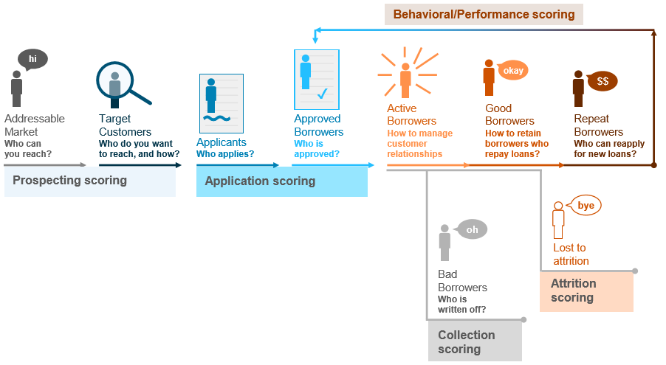
Lending - Credit Risk Modelling Lifecycle Funnel
Risk Scoring are quantified in different funnel for different business objectives / use case.
Each of the funnel have different label definition and should be treated as continuous scoring as part of Lending Portfolio metrics.
3. Behavior output
B-Score model Identifies good performers eligible for Limit Increase (UCI ML USE CASE)
1. Prospecting output
Whitelist Criteria
2. Application output
A-Score model Risk-based approach to predict PD (probability-of-default) based on DPD30+ or DPD90+
4. Collection output
C-Score model

Slide 8
Credit Risk Modelling - Behavior Score
Behavior / Repayment Scoring are composed of PD (Probability of Default) of the Repayment for the next DPD after certain period of time.
B Scoring helped Lending business to leverage many extensive properties like Fee, Promo, or to mitigate what kind of collection treatment that should be applied into certain bucket of B Score.
Many of Lending decisions that could be done after leverage of Behavioral Scoring as such :
CLIP ( Credit Limit Upgrade )
Categorical Product Drill Down Analysis
Collection Bucketing Treatment
Early Warning of highly default repayment
Funneling Application Score to Behavioral
Cross selling products willingness to buy

Slide 9
Credit Risk Modelling - Environment
All material all available in google shared drive : https://drive.google.com/drive/folders/1rCC9E42_XyvDP1SLwoKvWNfuMoMUF4b6?usp=sharing
All codes are in default anaconda 3 environment,
Categorical Handling : WoE (Weight of Evidence),
Final Output : Risk Rating Bucket, Recommendation to Cut-off, Explainable Features. Library Used for Predicting Model : Logistic Regression. Why Linear Model? Explained later

Slide 10
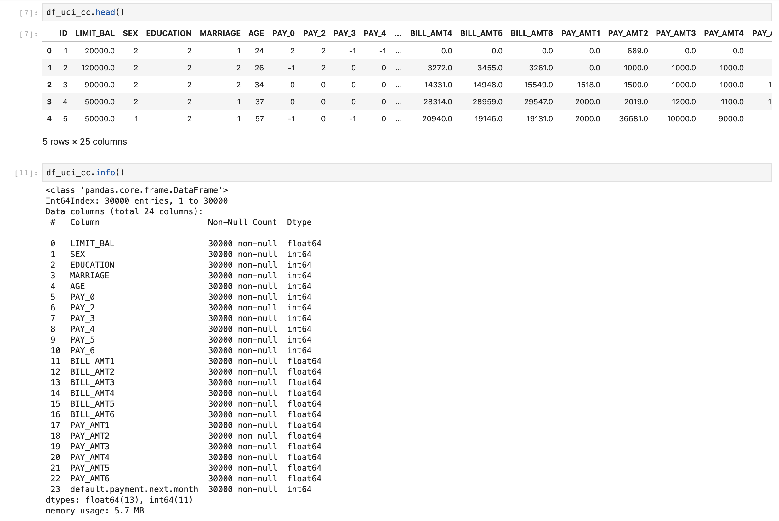
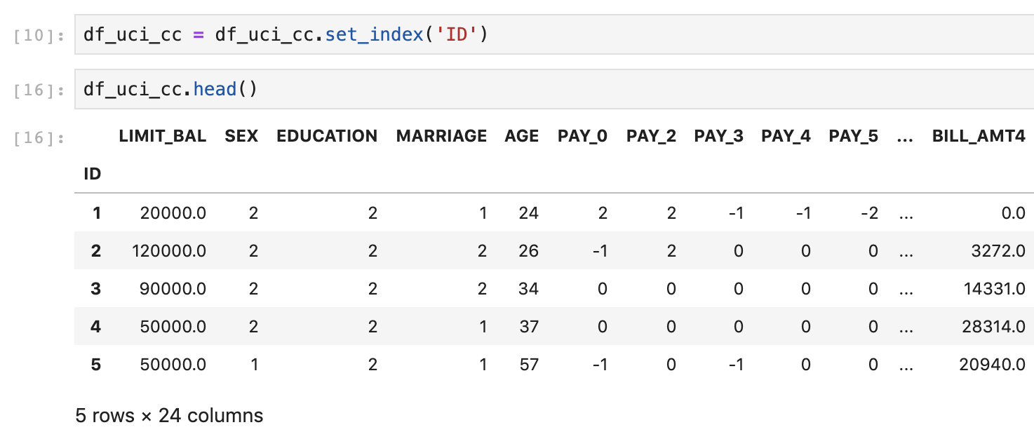
Hands on the Dataset….
Store the CSV into dataframe, then perform obvious field checking and null checking.
No Null Data found on the Dataframe, all the field have definitive Data Types.
Set “ID” into our Dataframe Index

Slide 11
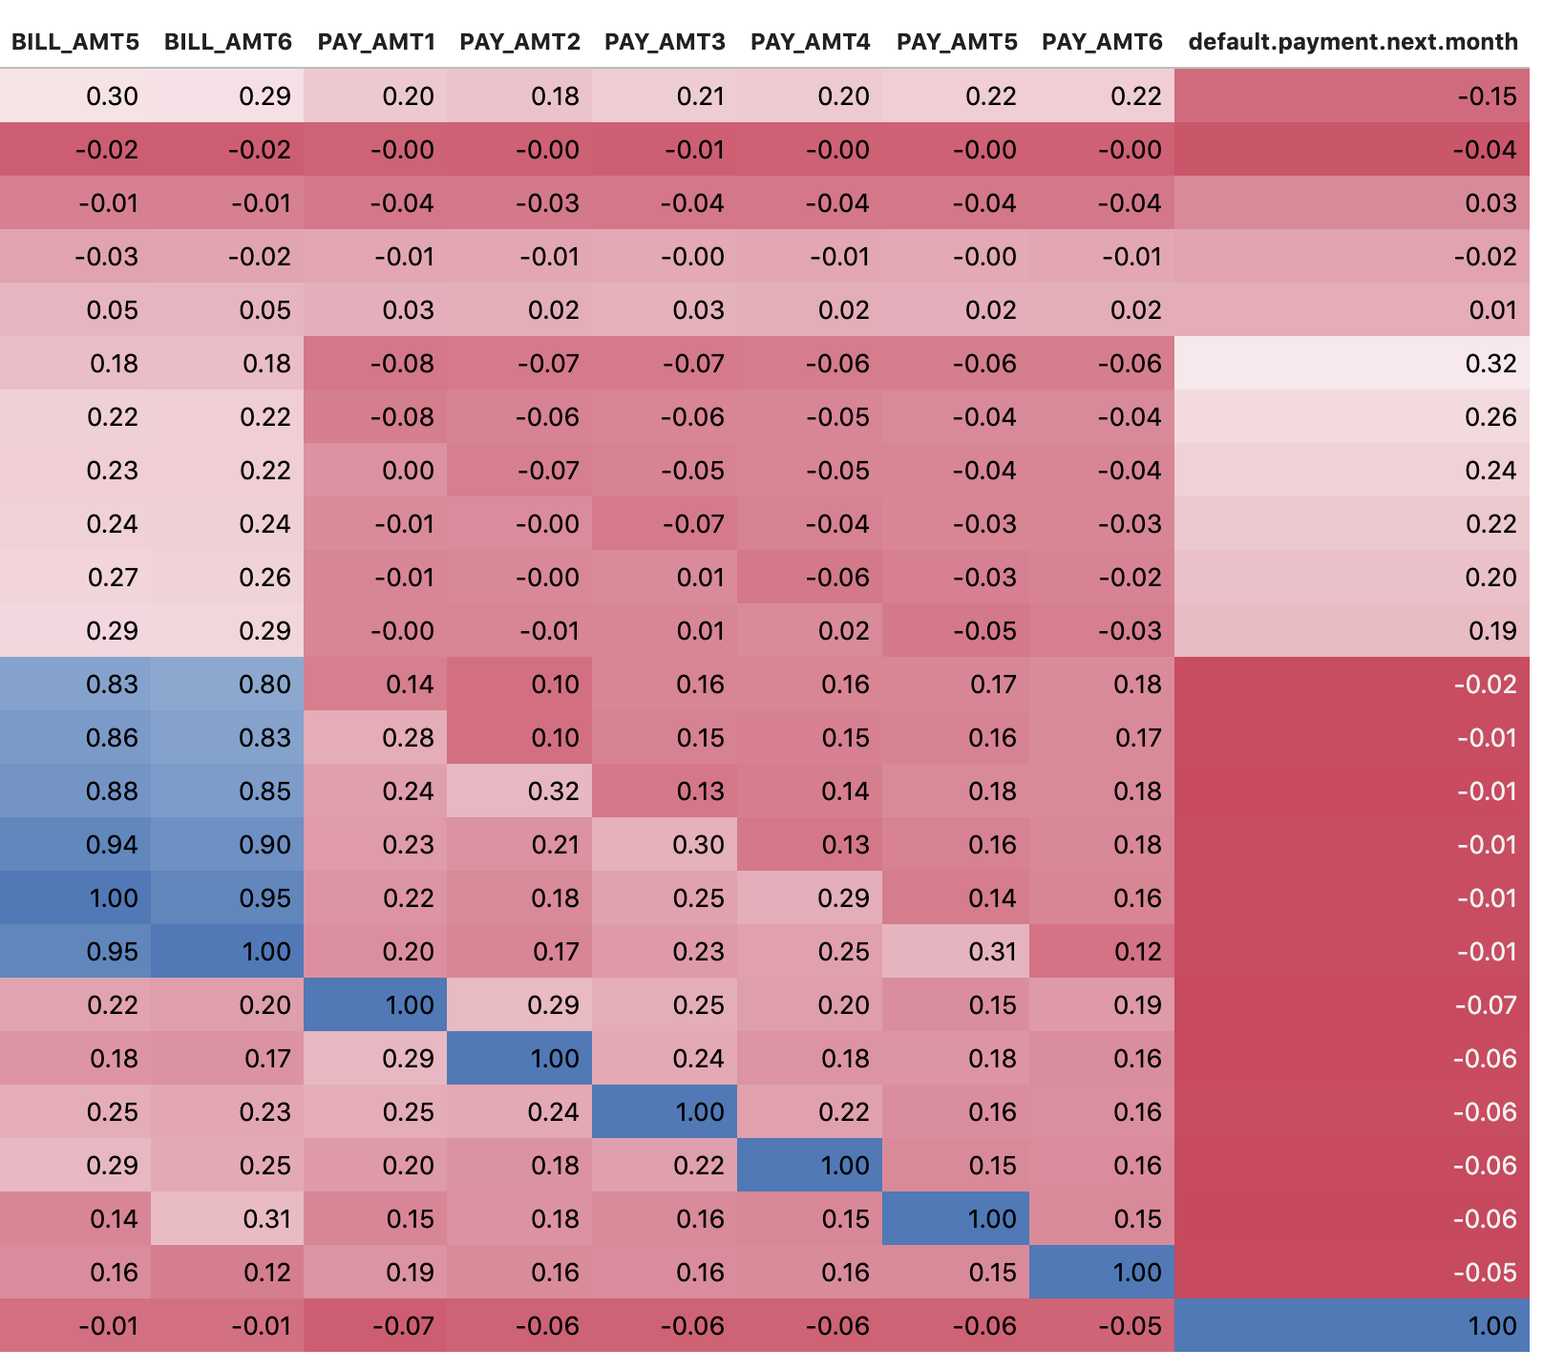
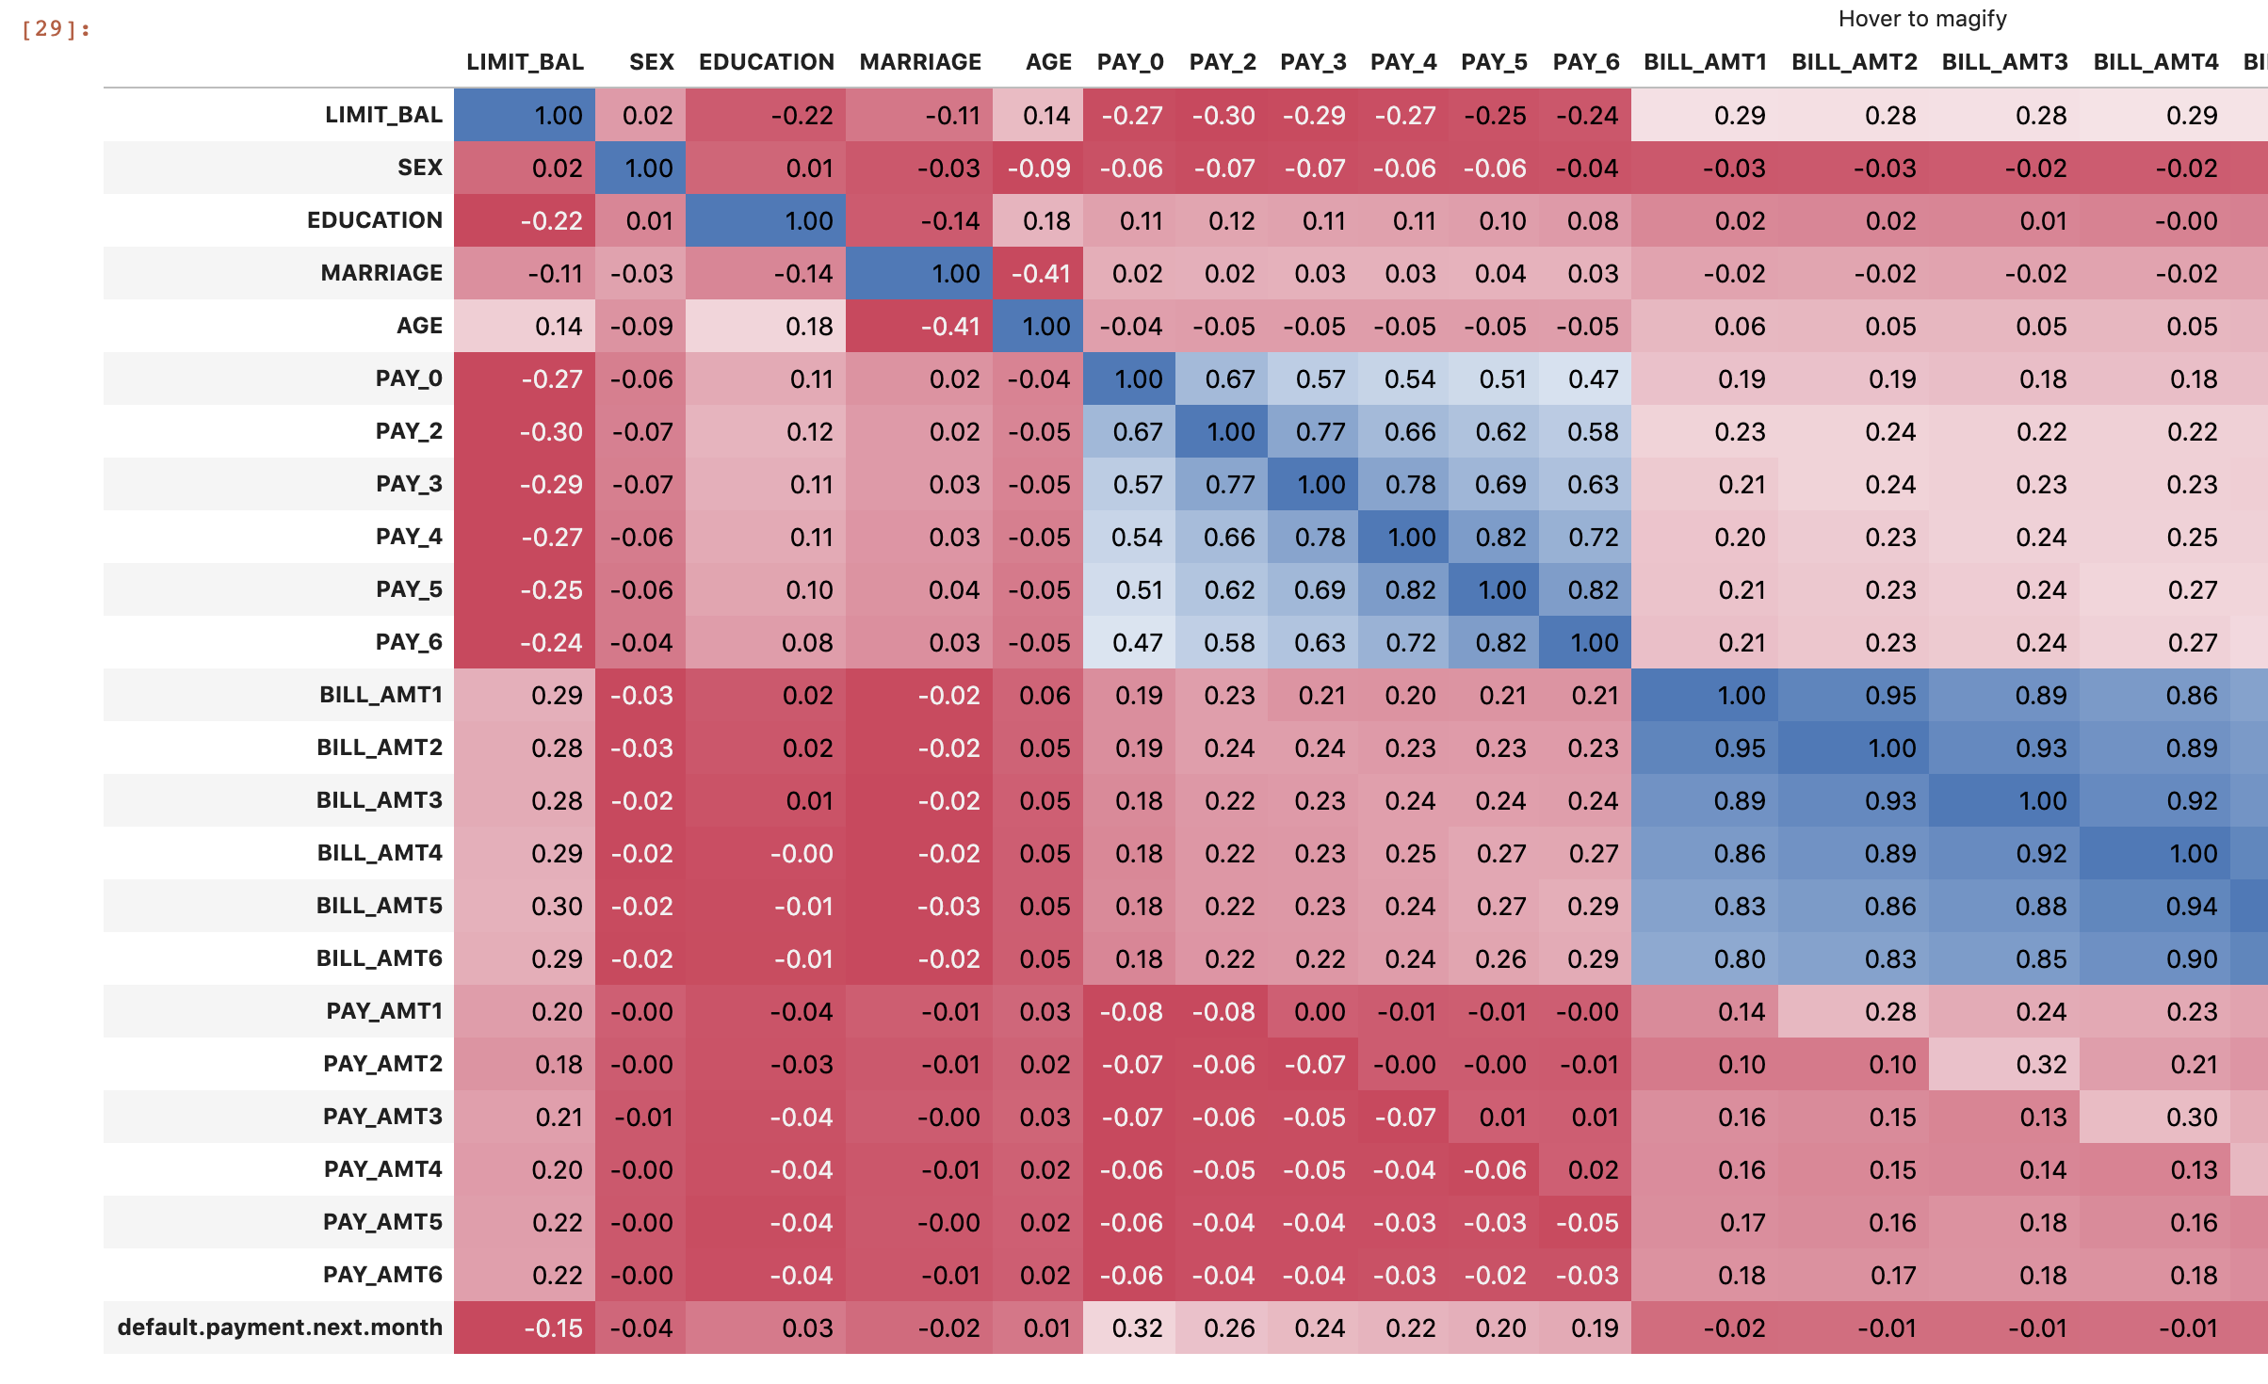
Sanitary Checking Part 1 - Correlation Matrix
Calculate Correlation Coefficient and build Corr Matrix to check sanitary value
Repayment status (PAY_0, PAY_xx) have strong predictor toward default label. Make sure no data leakage too.

Slide 12
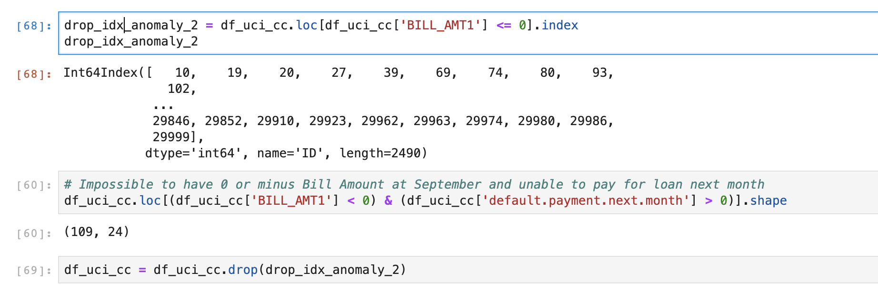
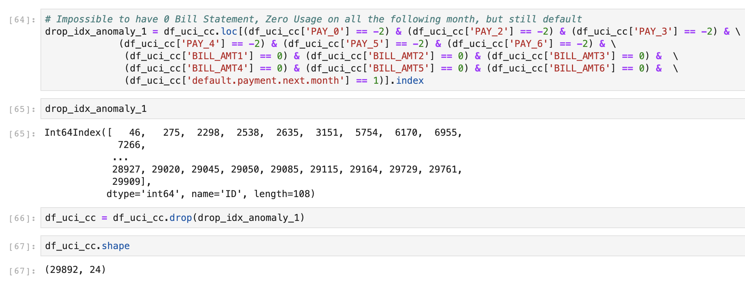
Bad data removal to improve data quality
Remove minus Amount of Bill Amount on October, and
Impossible to have 0 Bill Statement, Zero Usage on all the following month, but still default. We need to drop that data as doesn’t follow Lending pipeline.
Dropped almost 200 bad observations, then re-check the correlation matrix

Slide 13
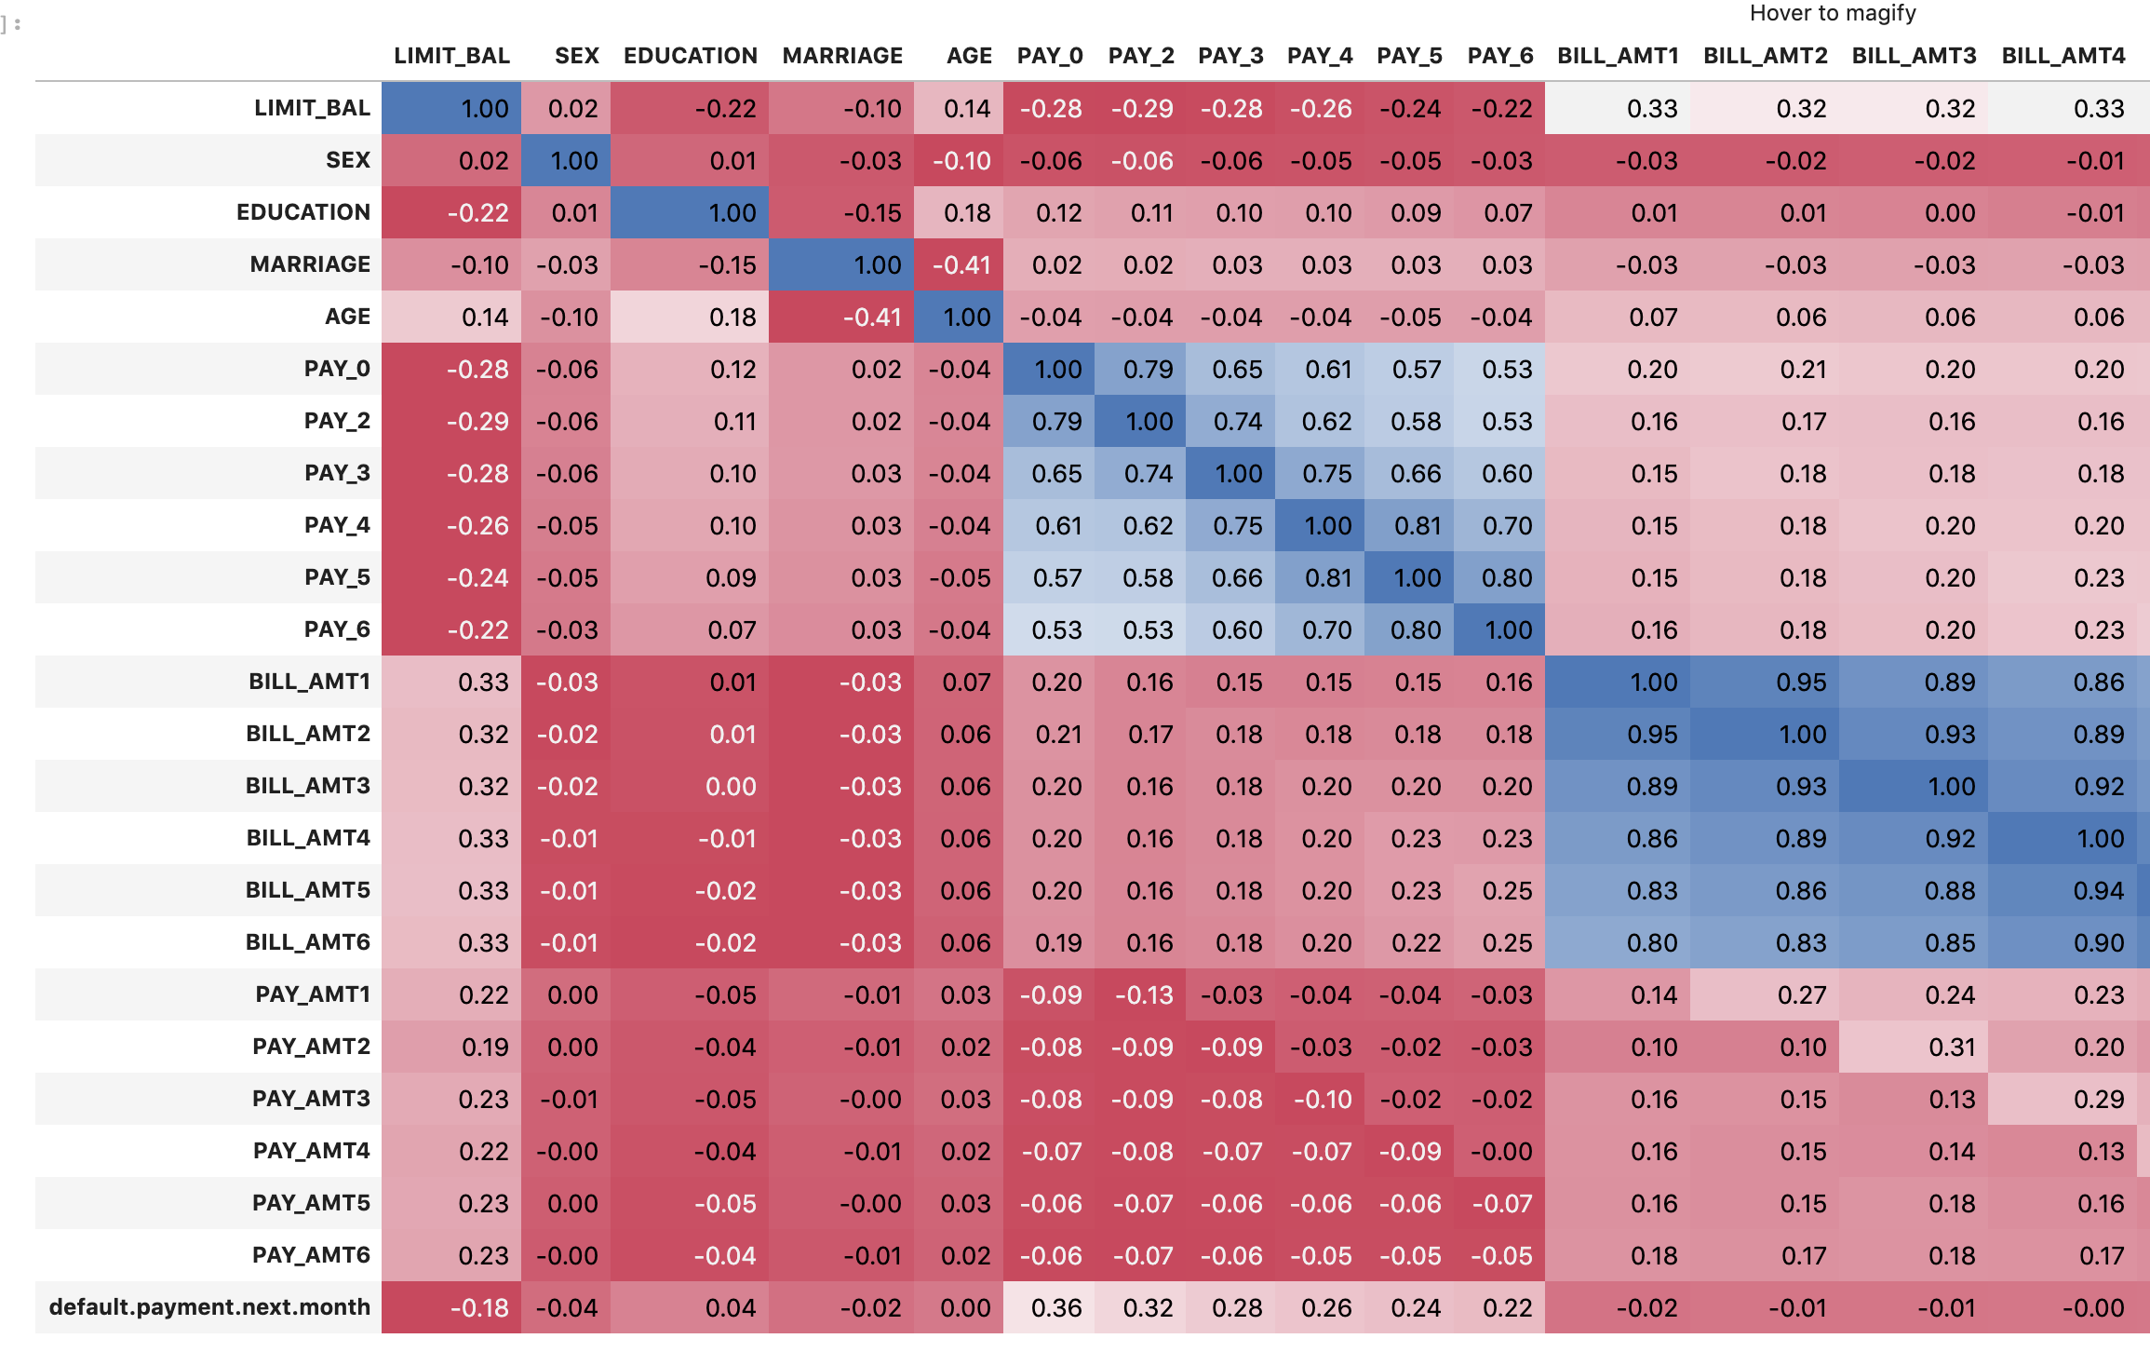
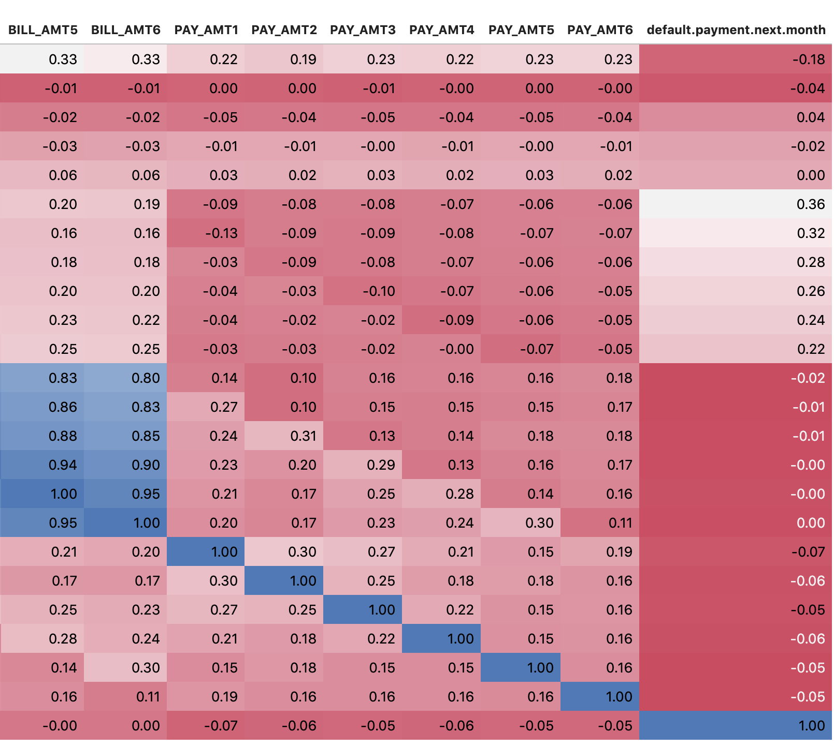
Correlation improved especially on Repayment status and bill amount,
Age correlation goes to 0 (verified later)

Slide 14
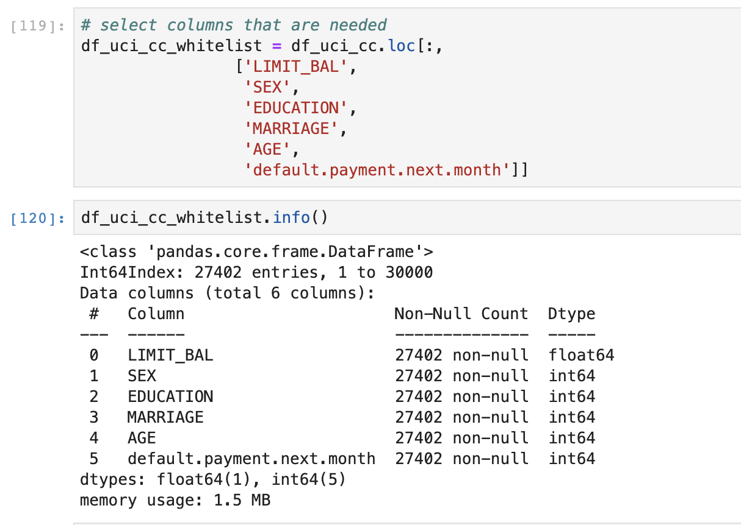
Feature Processing - Part 1
Holistic view, there are two (2) feature types,
Non Repayment Data, including Credit Balance and personal information and;
Repayment Data, including Repayment status and Bill Amount.
Begin to ingest Non Repayment Data to validate feature information

Slide 15
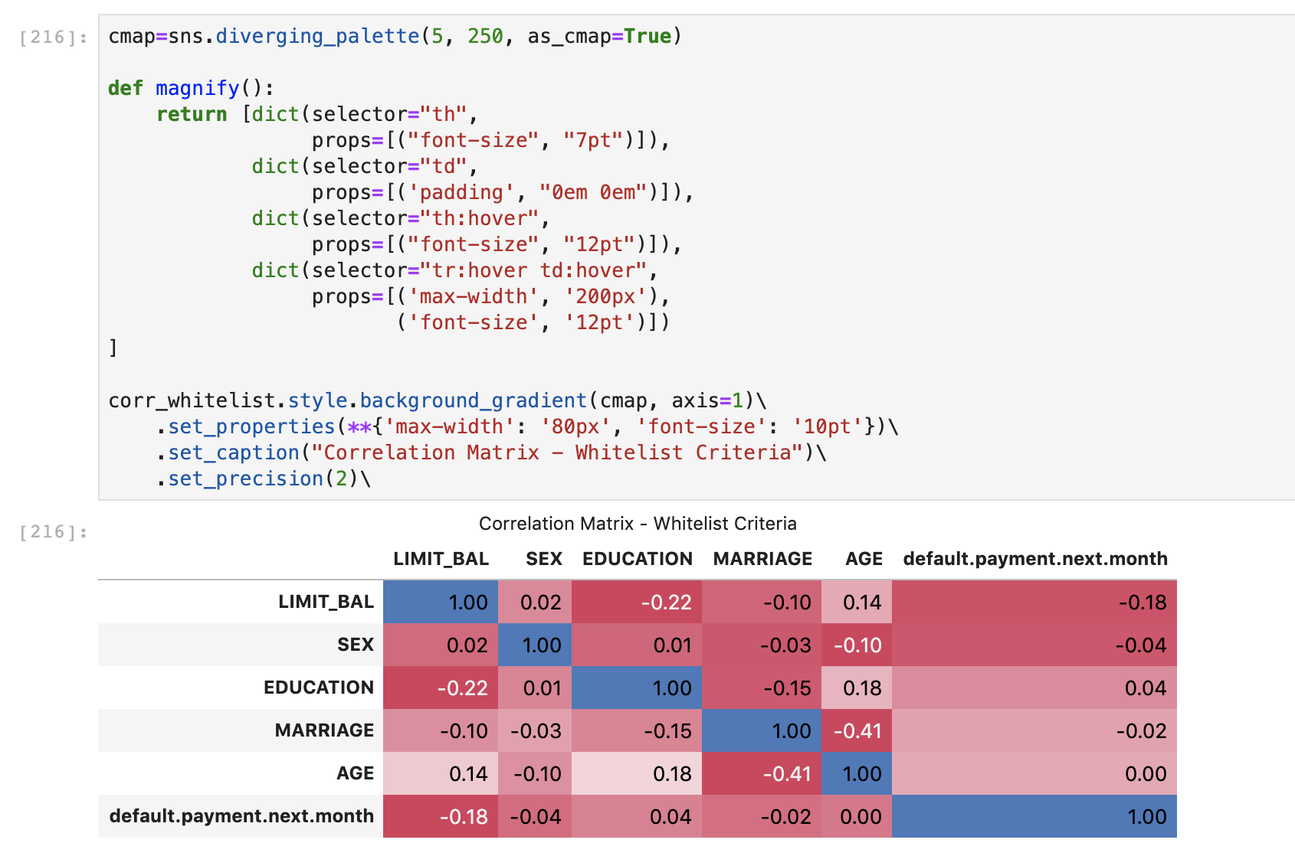
Feature Processing - Part 1
Age Correlation is 0 == dispersion of age is randomly distributed toward our target label (Only use as Legal Feature Criteria)
Limit Balance is minus power. This confirms us that,
This is not Application Scoring, the balance already been decided from funnel before this,
Limit Balance is already indicating ability Borrower to repay or fulfilling their obligation to finish the tenure.

Slide 16
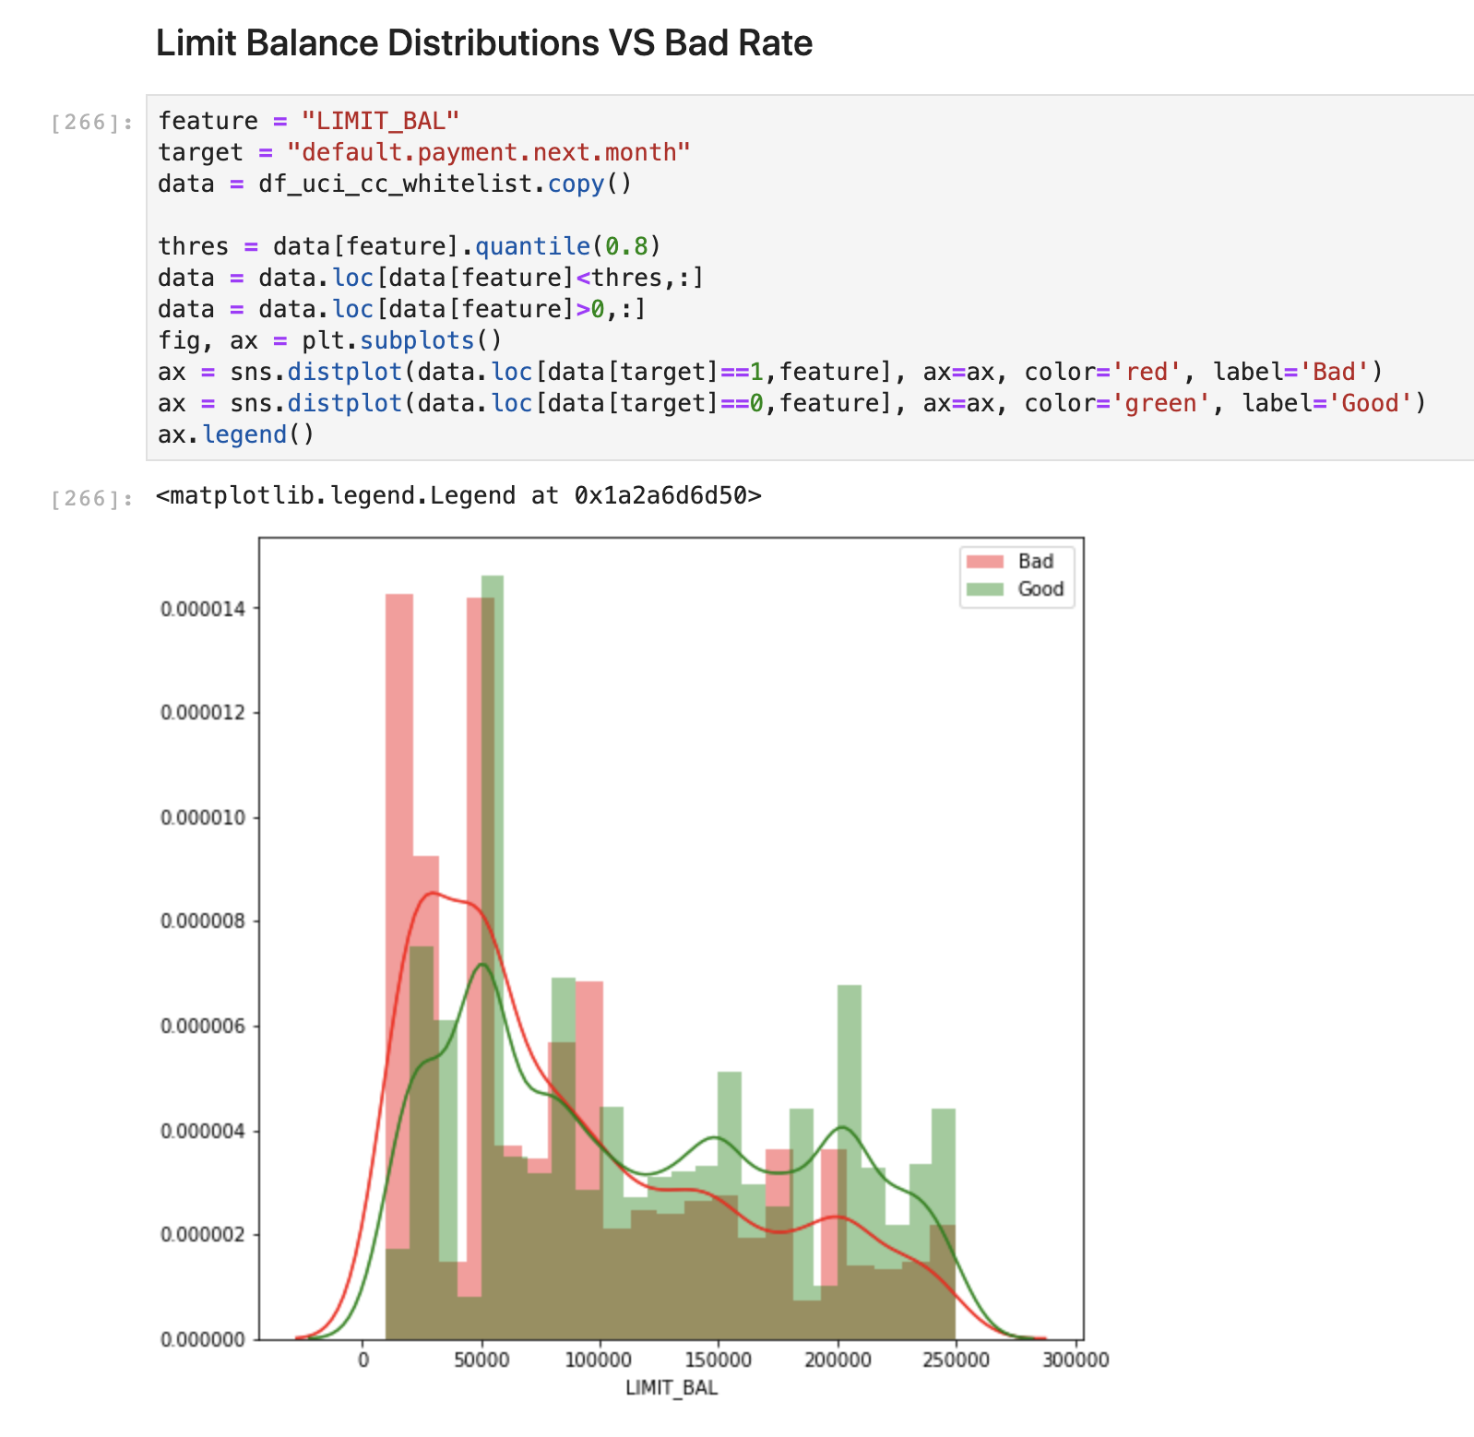
Statistically Testing for All the statements for Non Repayment Features
The bigger the balance is skewed toward good applicants. This confirms us that Limit Balance is the result from Application or previous Behavioral Scoring.

Slide 17
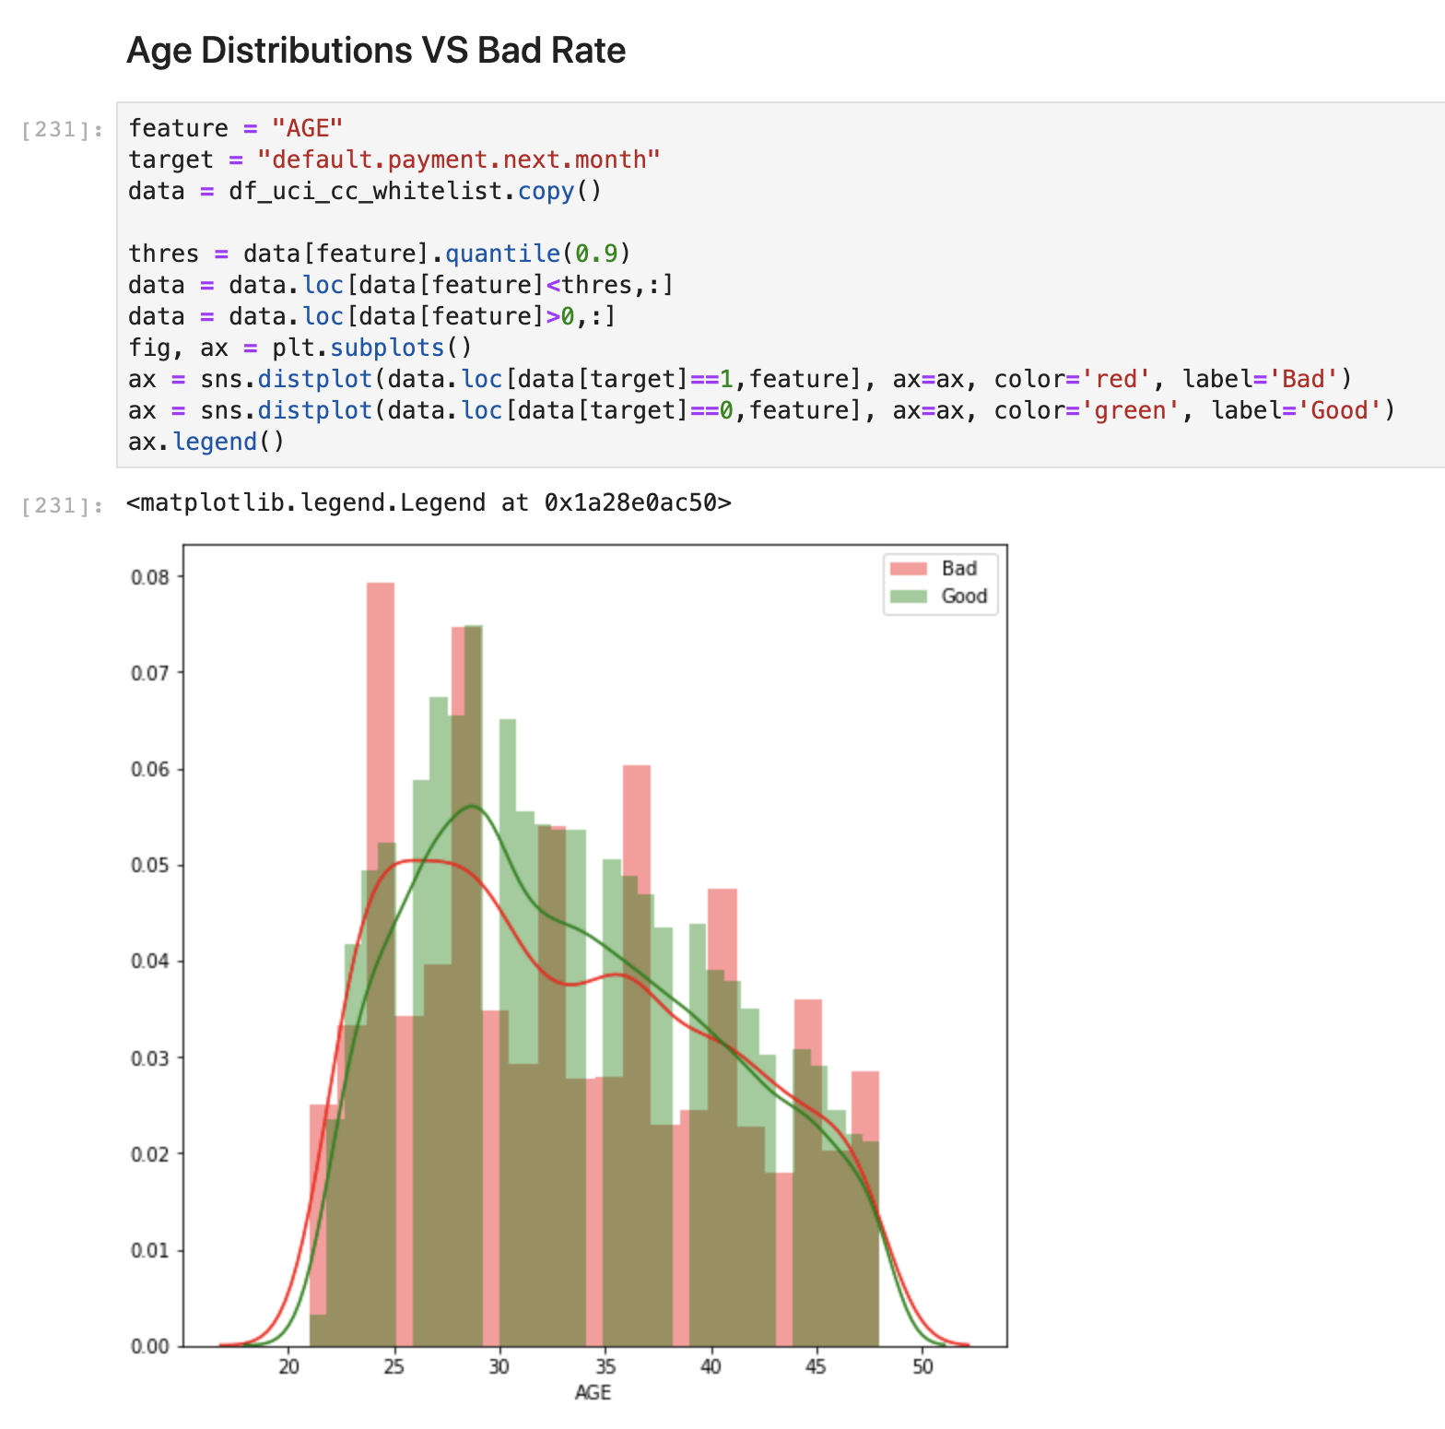
Statistically Testing for All the statements for Non Repayment Features
Bad rate is dispersed toward any direction of Age distribution, this confirms why Age correlation power toward our target label is 0. Hence it is not usable on our model, only for Legal Restrictions.
Plus, we do not need any bias PD toward Age Number of our Borrower

Slide 18
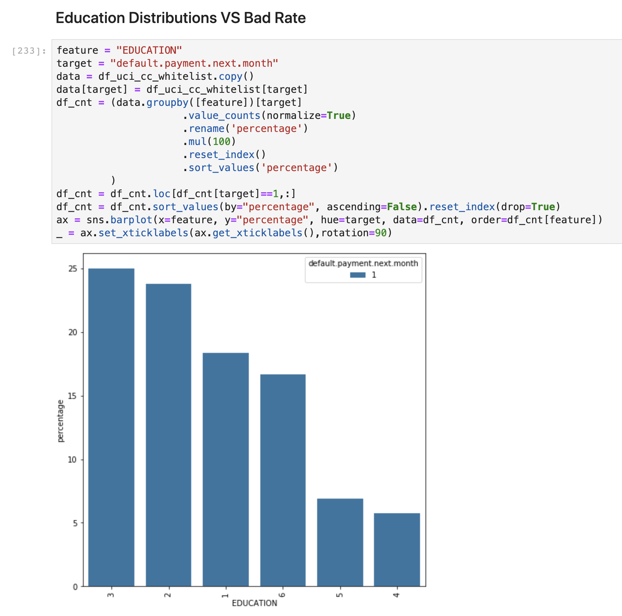
Statistically Testing for All the statements for Non Repayment Features
Known Education Label :
1 Grad School
2 University
3 High School
4 Others
5,6 Unknown
We should not incorporate unknown categorical that have different bad rate behavior like (5 & 6) as 6 is approx. 300% have more bad rate than 5
It is safe to group 4 & 5 as the bad rate percentage is tightly the same rate

Slide 19
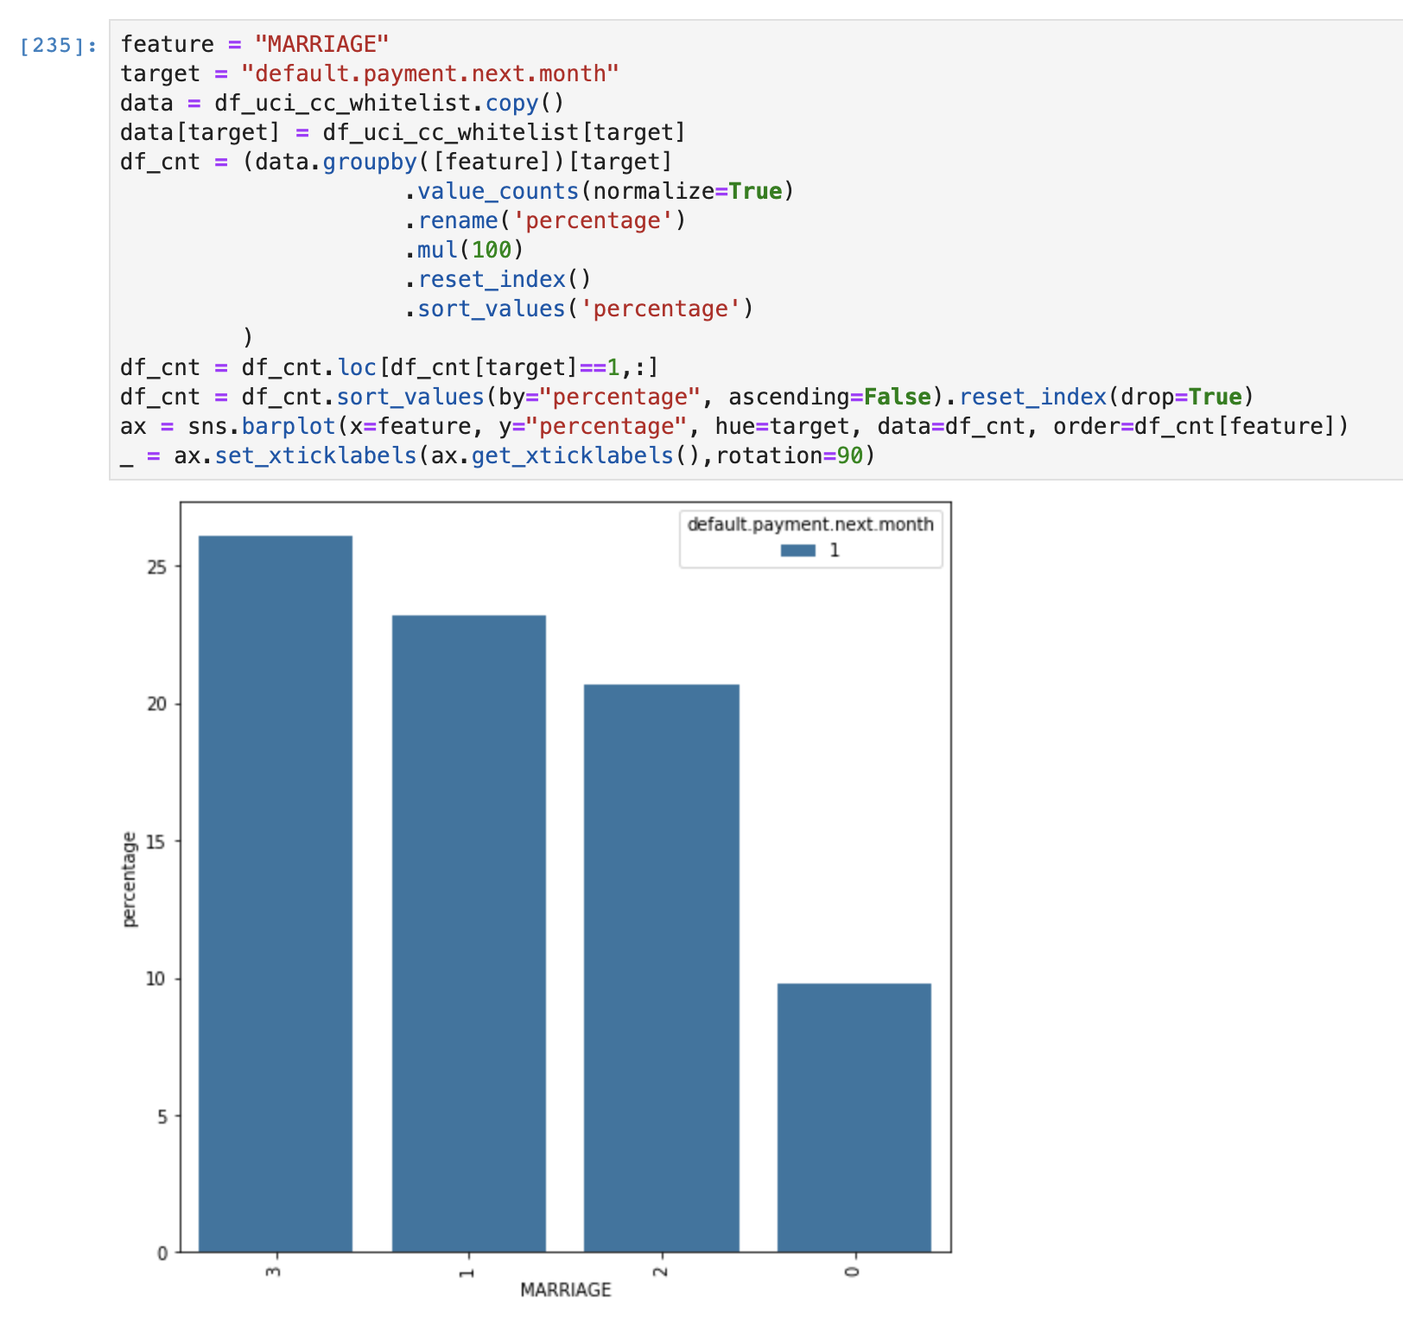
Statistically Testing for All the statements for Non Repayment Features
Known Marriage Label :
1 Married
2 Single
0, 3 Others
We should not incorporate unknown categorical that have different bad rate behavior like (0 & 3) as 3 is approx. 250% have more bad rate than 0
It is safe to group 1 & 2 as the bad rate percentage is tightly the same rate

Slide 20
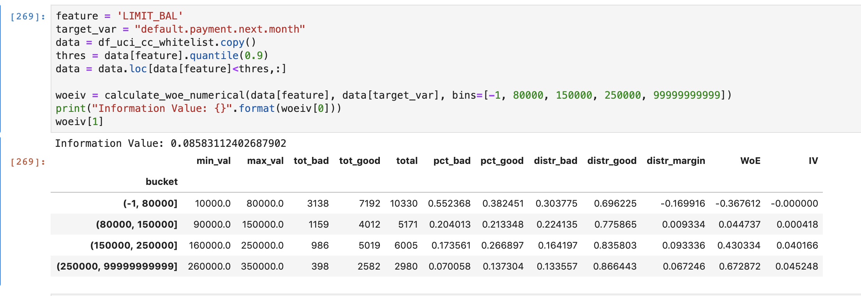
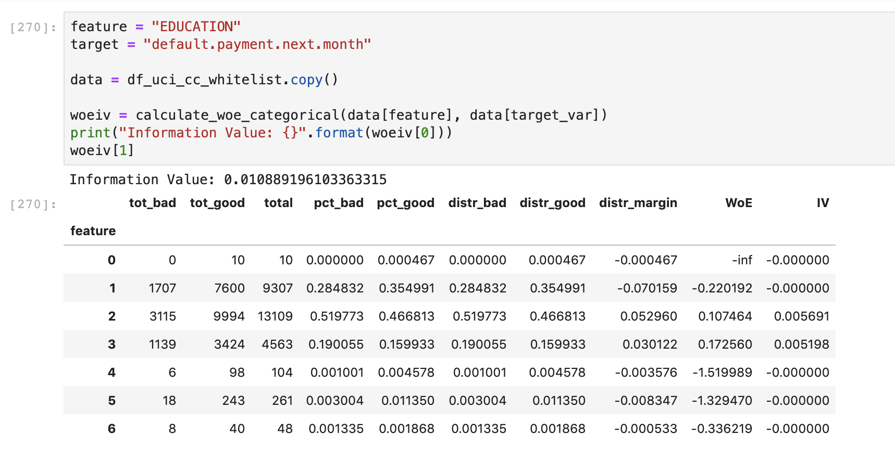
Categorical Processing - Part 2
Following Basel, and for the sake of easier to maintain, rigor productionize model, and taking advantage of the bad rate composition (Weight of Evidence) in order to more have statistically proven categorical rather than creating a lot of dummy variables.
Don’t forget the less variable you have, easier to maintain and you can control each of them more manually in the later if we want to apply specific policy (eg. tighten acceptance criteria, power feature testing, so on)
Notes:
Categorical Processing using statistical method in order to have more control in Feature Interaction later in Linear Model.
Handling continuous variable and categorical variable is different, see my packages for the self explanation,

Slide 21
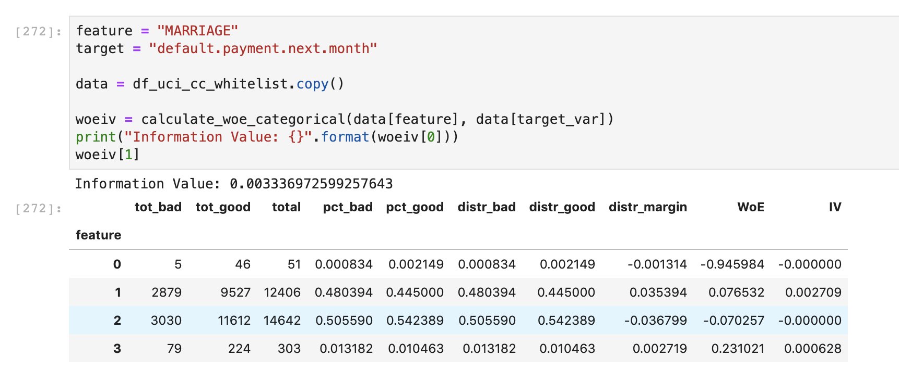
Categorical Processing - Part 2
3. Ensure the WoE power goes grow ascending or descending depends on the target definition and the direction that we are going to map
Notes:
Categorical Processing using statistical method in order to have more control in Feature Interaction later in Linear Model.
Handling continuous variable and categorical variable is different, see my packages for the self explanation,

Slide 22
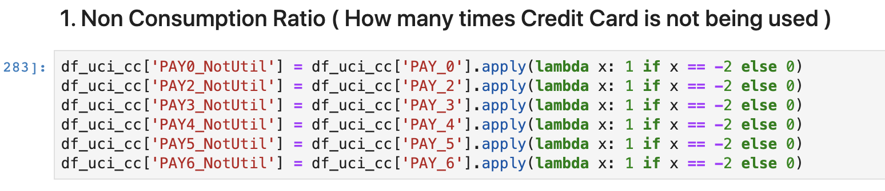
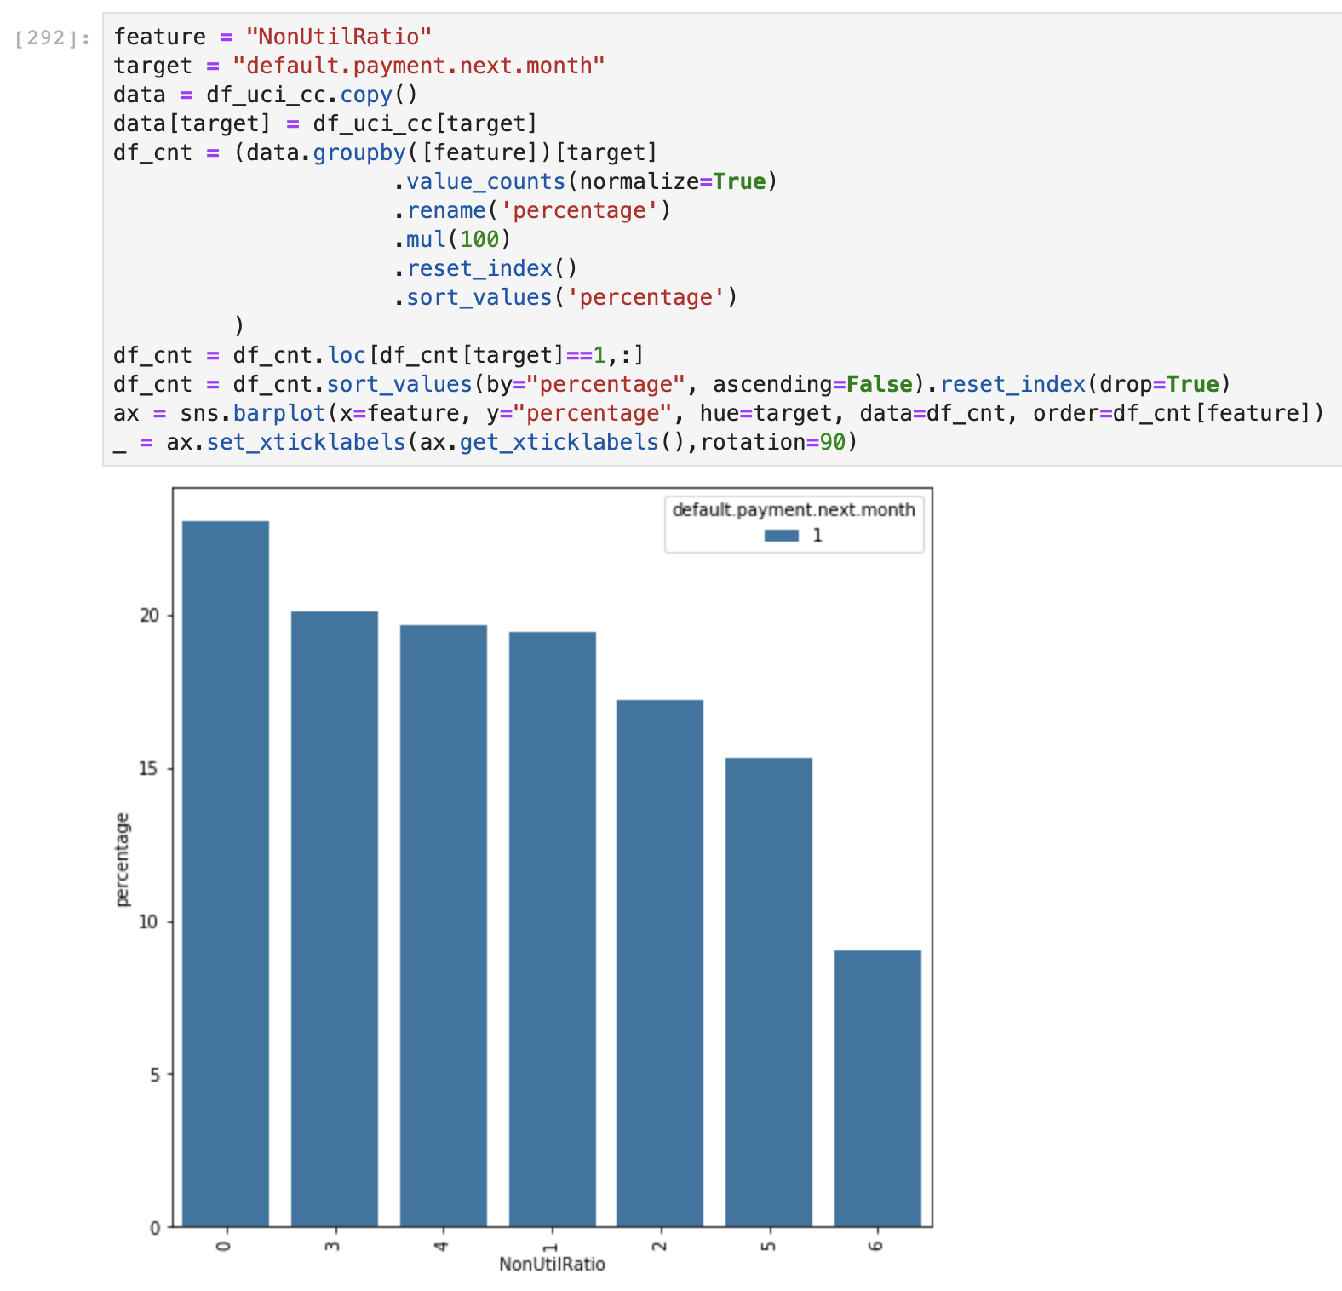
Repayment Feature Processing - Part 3
Non Consumption Ratio ( How many times Credit Card is not being used )
Proven that the more often the usage, the lowest the bad rate composition will be.
Notes:
Categorical Processing using statistical method in order to have more control in Feature Interaction later in Linear Model.
Handling continuous variable and categorical variable is different, see my packages for the self explanation,

Slide 23
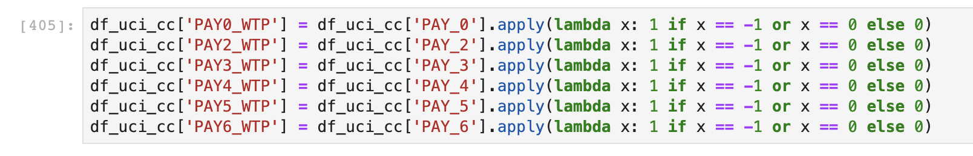
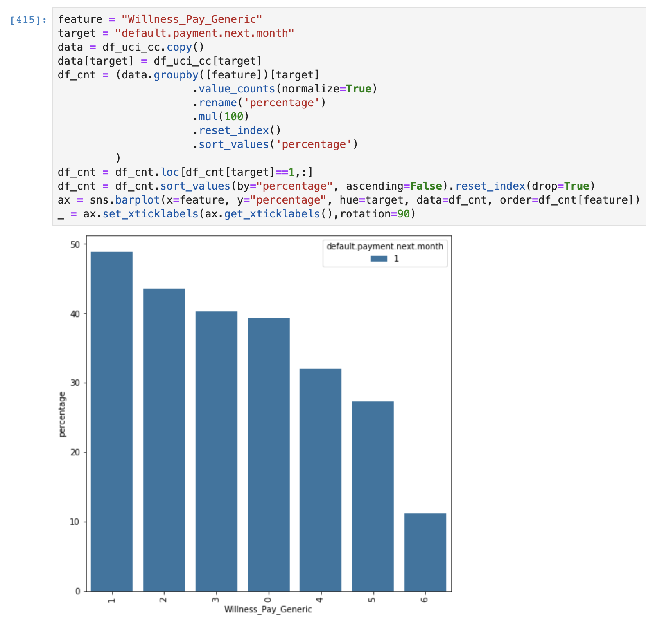
Repayment Feature Processing - Part 3
Willingness To Pay Features
Willingness to pay generic meaning that how willing each borrower to pay the least at minimum amount for reach repayment cycle, and it proves have skewed power toward our default label.
Notes:
Categorical Processing using statistical method in order to have more control in Feature Interaction later in Linear Model.
Handling continuous variable and categorical variable is different, see my packages for the self explanation,

Slide 24
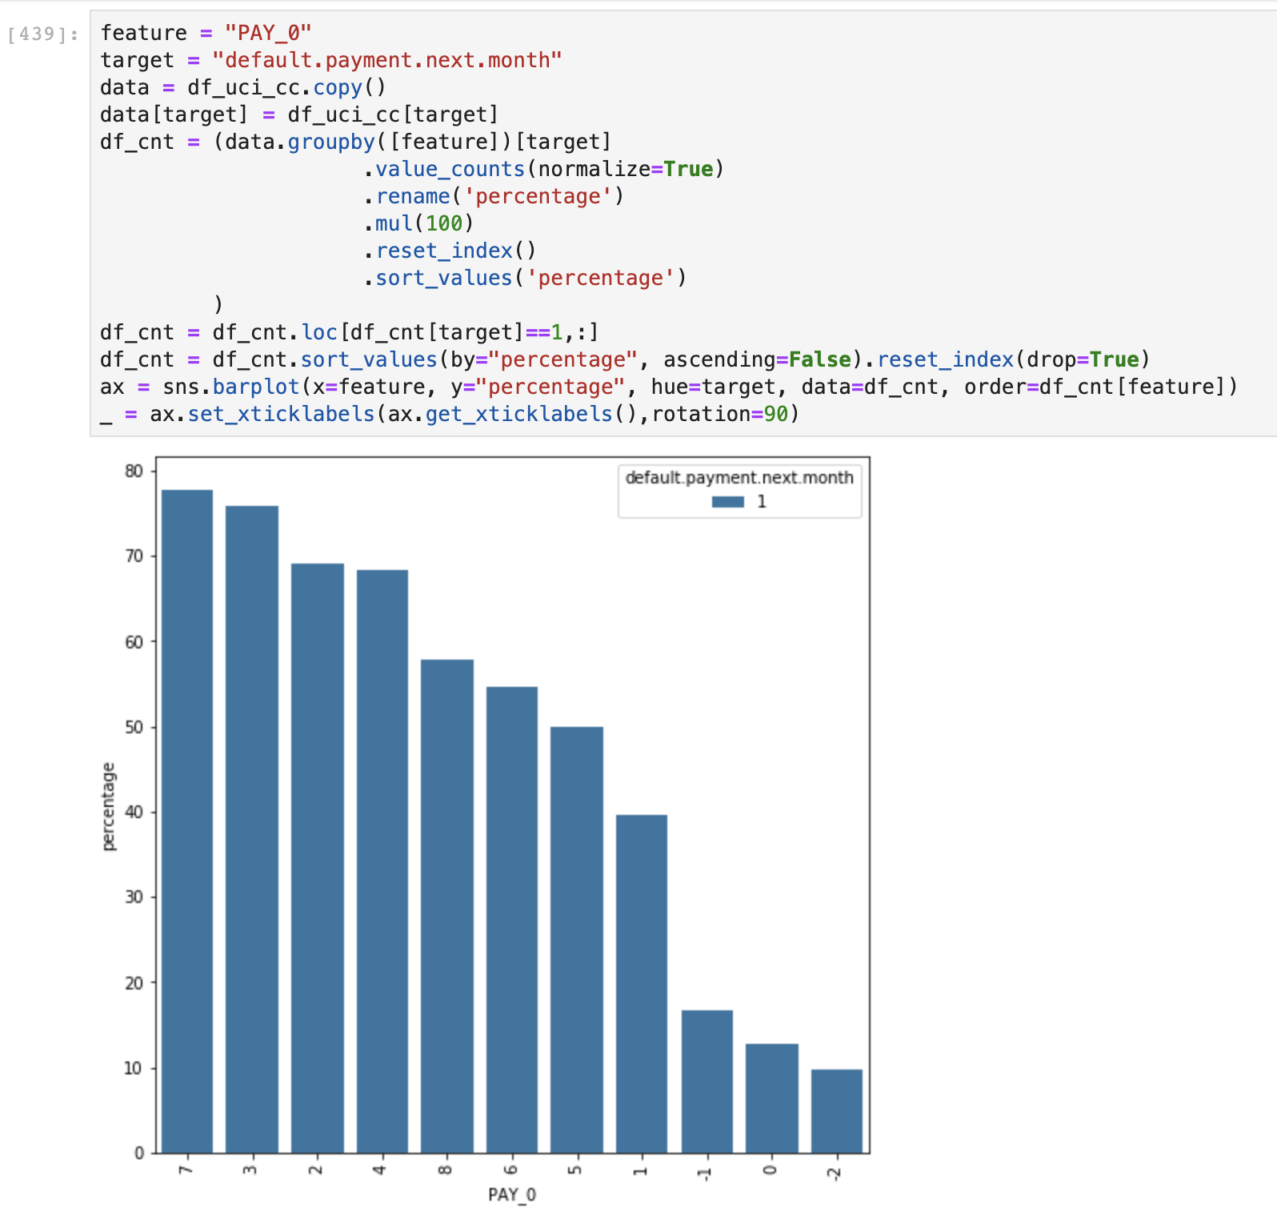
Payment Feature Processing - Part 4
In Scoring composition, we have two (2) main parts that composing our PD :
Historical Data ( Consistency, Slope, so on)
Current active datapoint that reflect the last condition right before scoring)
On current active datapoint, we set to the most powerful which is PAY_0 (Current Repayment Status) and BILL_AMT1 (Current Bill Issued Outstanding Amount)
This indicates there is risk rank growth of bad rate, less usage or non default repayment status have a less likelihood toward bad rate or default in the next month.
Notes:
Categorical Processing using statistical method in order to have more control in Feature Interaction later in Linear Model.
Handling continuous variable and categorical variable is different, see my packages for the self explanation,

Slide 25
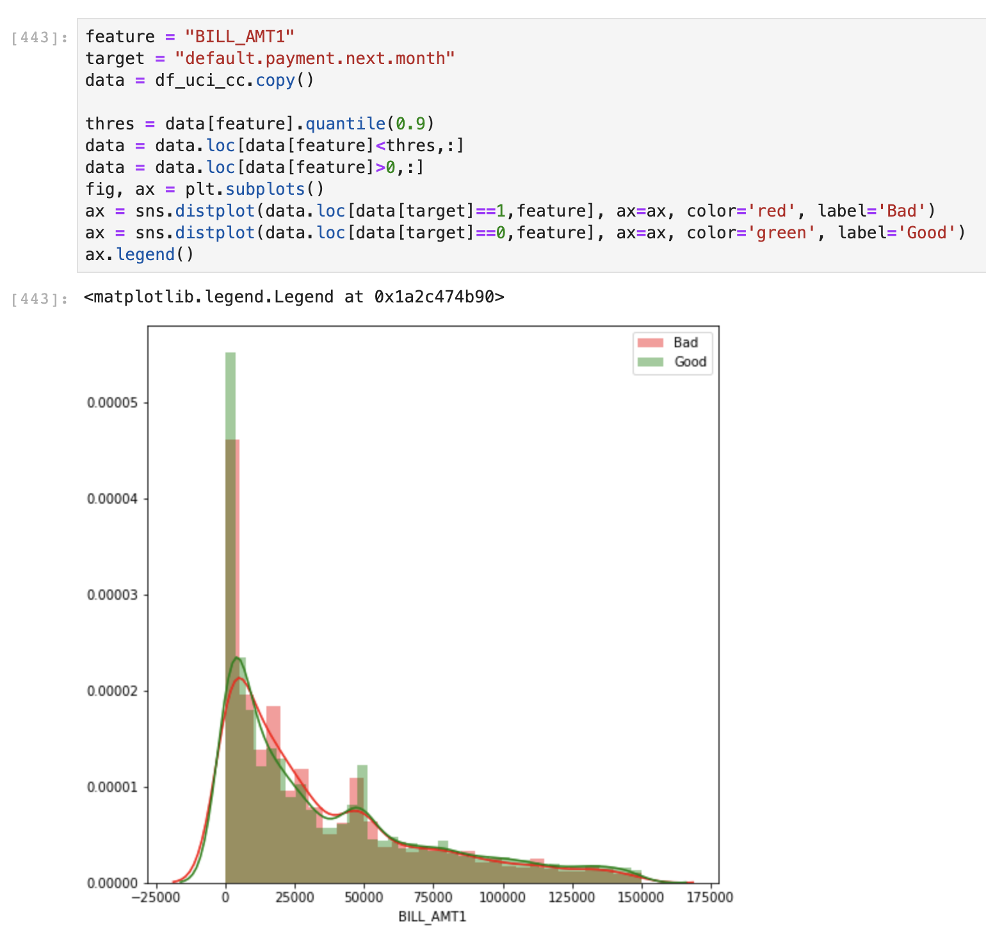
Payment Feature Processing - Part 4
In Scoring composition, we have two (2) main parts that composing our PD :
Historical Data ( Consistency, Slope, so on)
Current active datapoint that reflect the last condition right before scoring)
On current active datapoint, we set to the most powerful which is PAY_0 (Current Repayment Status) and BILL_AMT1 (Current Bill Issued Outstanding Amount)
This indicates the less current Outstanding Billed amount for the current month, the less likelihood those borrower toward bad rate / default next month.
Notes:
Categorical Processing using statistical method in order to have more control in Feature Interaction later in Linear Model.
Handling continuous variable and categorical variable is different, see my packages for the self explanation,

Slide 26
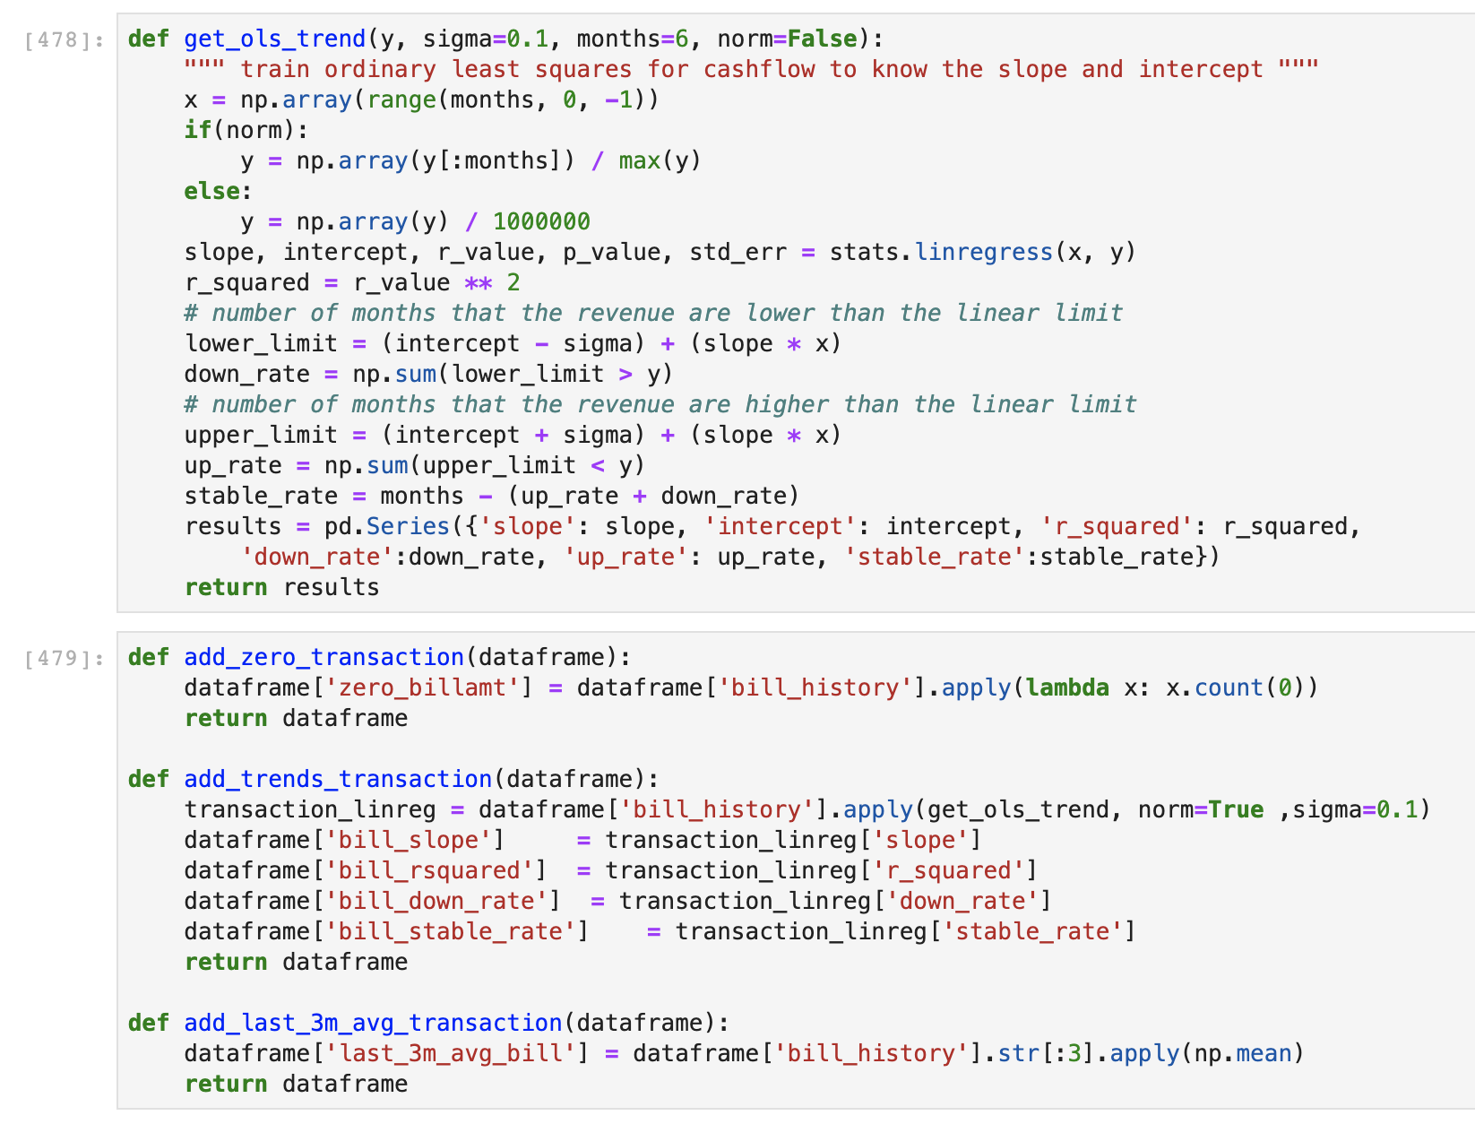
Historical Derivative Features - Part 5
For historical features, we need to derivative several features that can extrapolate key information like consistency, uptrend / downtrend, slope of the amount / status, or the average of the most recent of the historical values.
Based on all that facts and methodology, we able to derive features like :
Slope of the Bill Amount,
Down Rate (Indicates finished tenure, trend cleaning debt), Stable Rate, R Squared of Bill Amount
Last 3M of Billed Amount, Median of Last 6M Billed Amount, Zero_BillAmount (How many 0 outstanding amount from last 6M)
Notes:
Categorical Processing using statistical method in order to have more control in Feature Interaction later in Linear Model.
Handling continuous variable and categorical variable is different, see my packages for the self explanation,

Slide 27
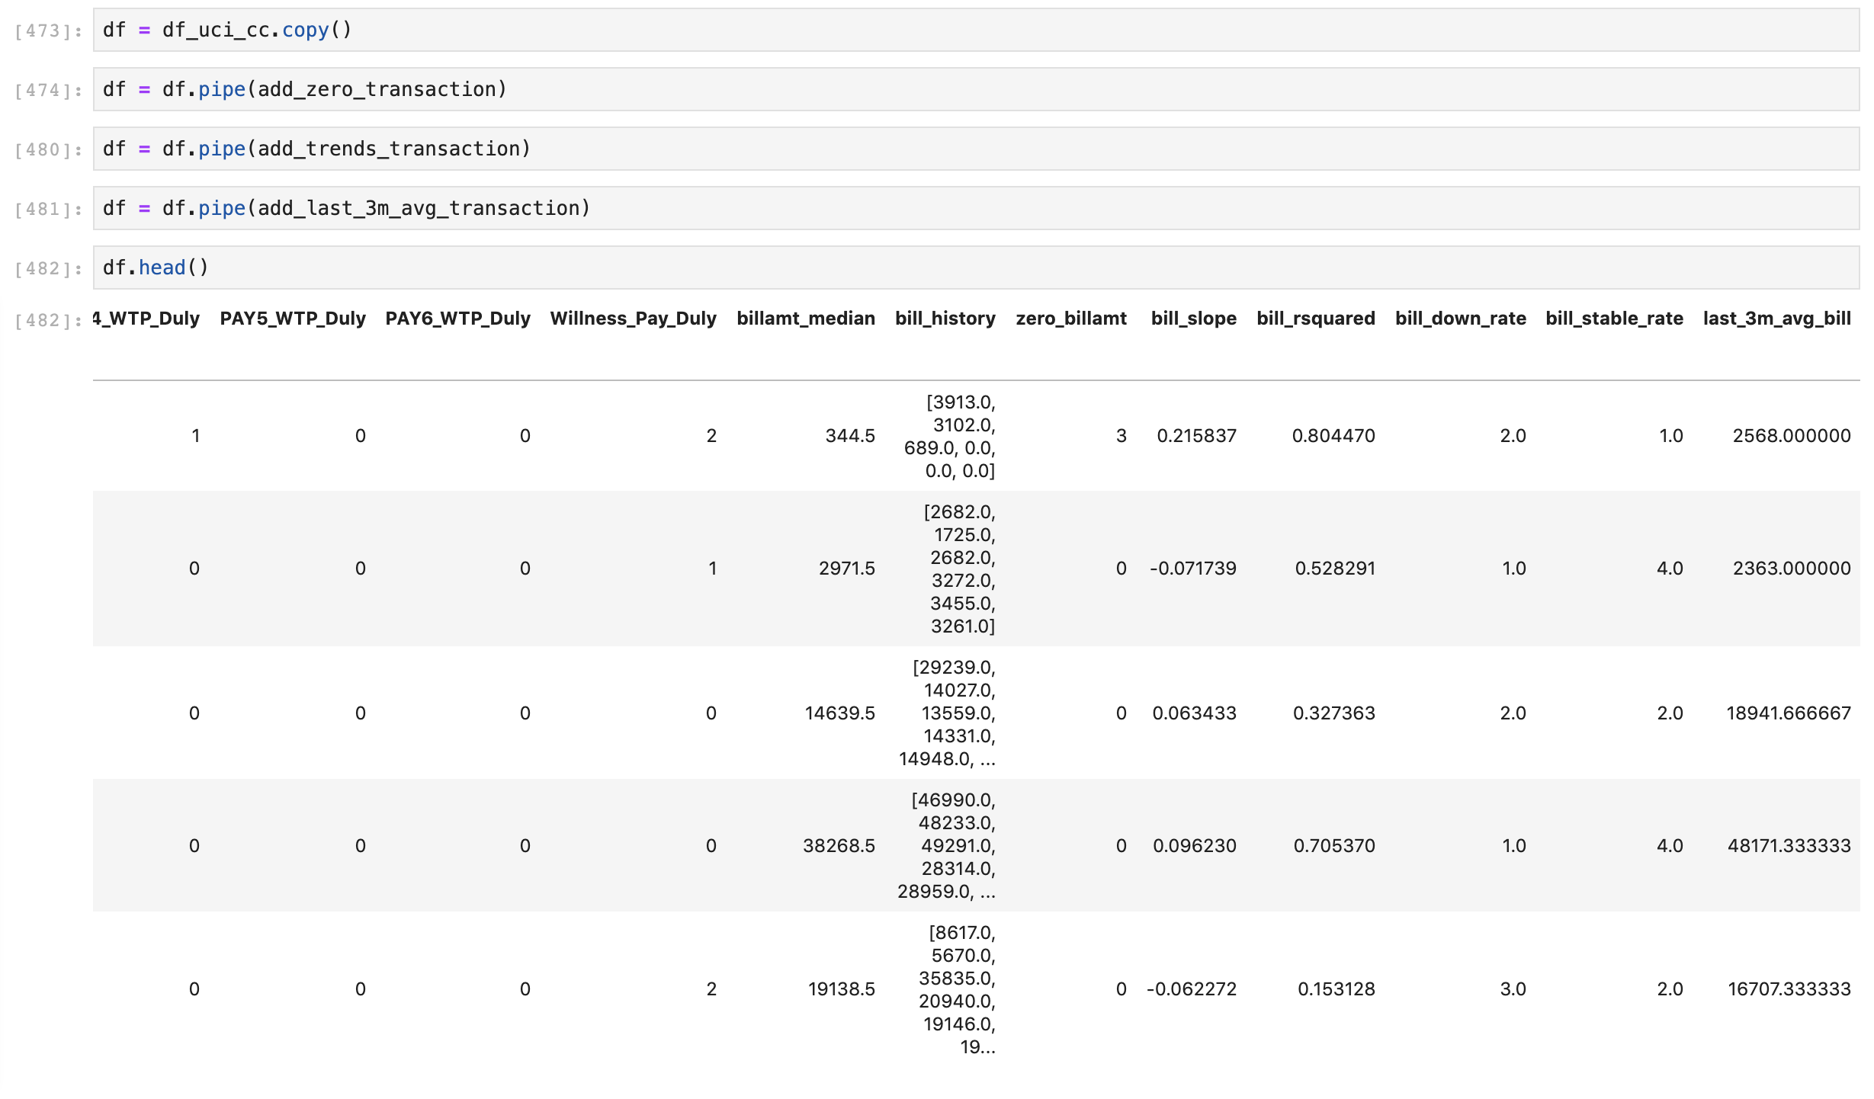
Historical Derivative Features - Part 5
For historical features, we need to derivative several features that can extrapolate key information like consistency, uptrend / downtrend, slope of the amount / status, or the average of the most recent of the historical values.
Based on all that facts and methodology, we able to derive features like :
Slope of the Bill Amount,
Down Rate (Indicates finished tenure, trend cleaning debt), Stable Rate, R Squared of Bill Amount
Last 3M of Billed Amount, Median of Last 6M Billed Amount, Zero_BillAmount (How many 0 outstanding amount from last 6M)
Notes:
Categorical Processing using statistical method in order to have more control in Feature Interaction later in Linear Model.
Handling continuous variable and categorical variable is different, see my packages for the self explanation,

Slide 28
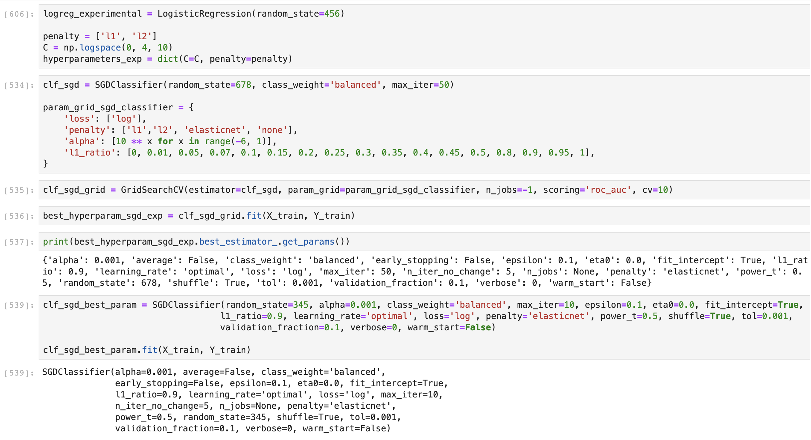
SGD (Stochastic) Model Pipeline
Why Linear Model?
No need to recalibrate the output PD at end of the process
From our previous investigation, statistical testing and WoE still shown the relational between independent feature toward dependent variables, linear model should be able to generalize this dataset pattern
We can extrapolate feature importance by extracting variable coefficient that have the direction. More interpretable rather than Feature Importance.
Standardised any amount variables because the differences power of amount variables is high unlike WoE that already in Ratio format.
Why Stochastic?
Faster to training, derivative from Linear Models
Train Test Split with random seed enabled to perform SearchCV with multiple folds.

Slide 29
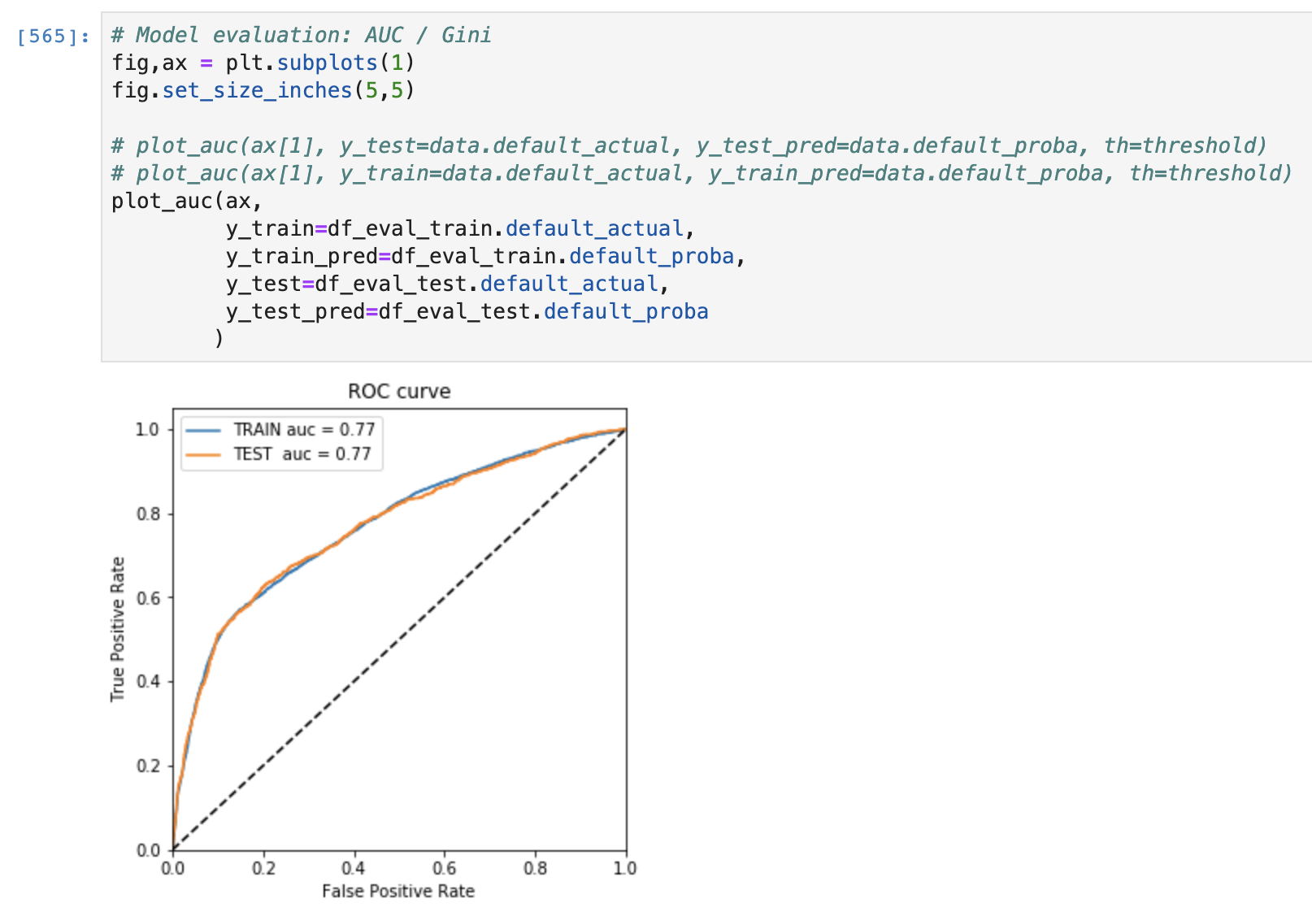
Model Evaluation
AUC and KS
Shown that with linear models and limited features, we are able to beat current National Bank Standard which on AUC 0.60
Our derivative features are able to distinguished bad and good borrower in their October Repayment Cohort because we take into consideration Willingness To Pay and carefully taking care the unknown categorical label.
No Significant performance over training and testing population. Which mean we succeed to generalize and not overfit the model given such population. This are caused by :
We using baseline Linear model with default gridsearch hyperparam, and
Our classification population is not imbalanced so disperse, around 78 : 22

Slide 30
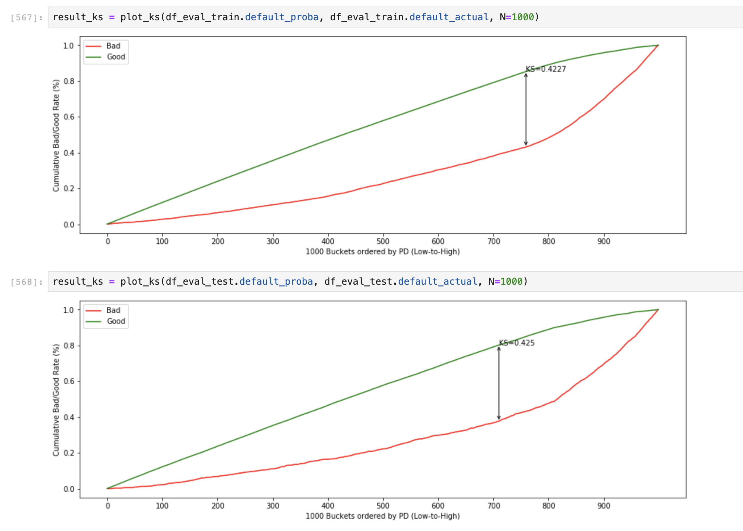
Model Evaluation
AUC and KS
Shown that with linear models and limited features, we are able to beat current National Bank Standard which on AUC 0.60
Our derivative features are able to distinguished bad and good borrower in their October Repayment Cohort because we take into consideration Willingness To Pay and carefully taking care the unknown categorical label.
No Significant performance over training and testing population. Which mean we succeed to generalize and not overfit the model given such population. This are caused by :
We using baseline Linear model with default gridsearch hyperparam, and
Our classification population is not imbalanced so disperse, around 78 : 22

Slide 31
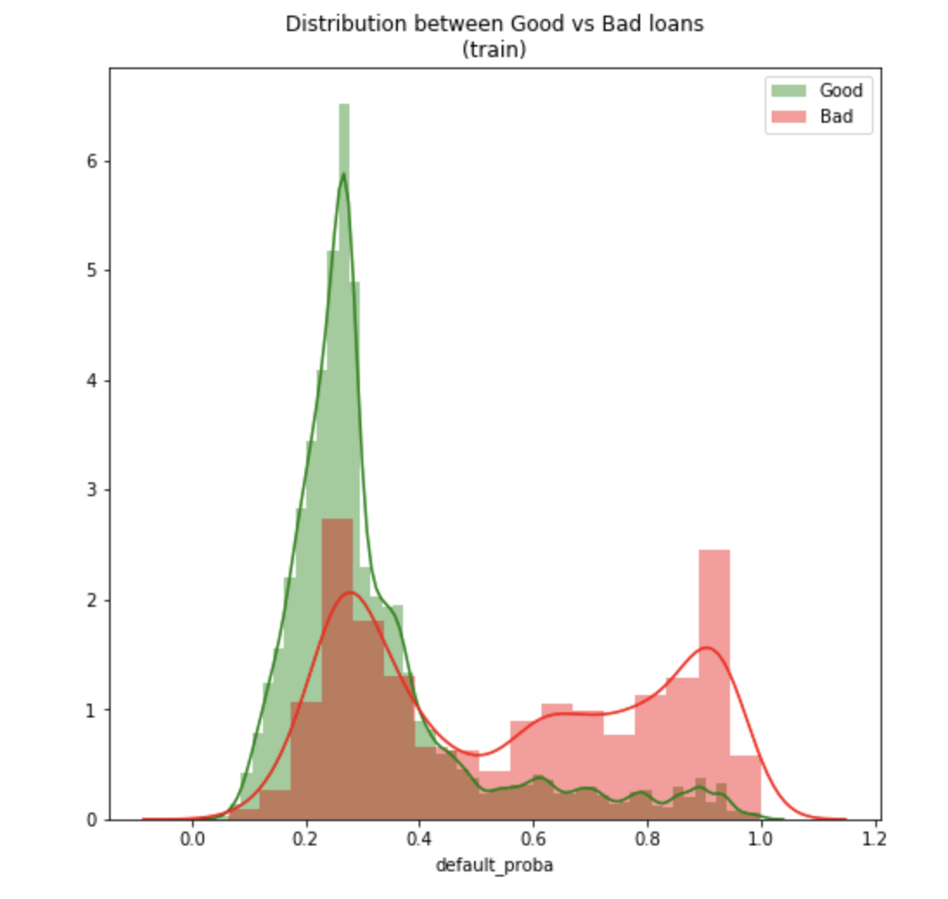
Model Evaluation - PD Separation
PD Population Separation
Our Linear model are capable to separate two whole classification risk-rank (Good More->Less, Bad Less->More)

Slide 32
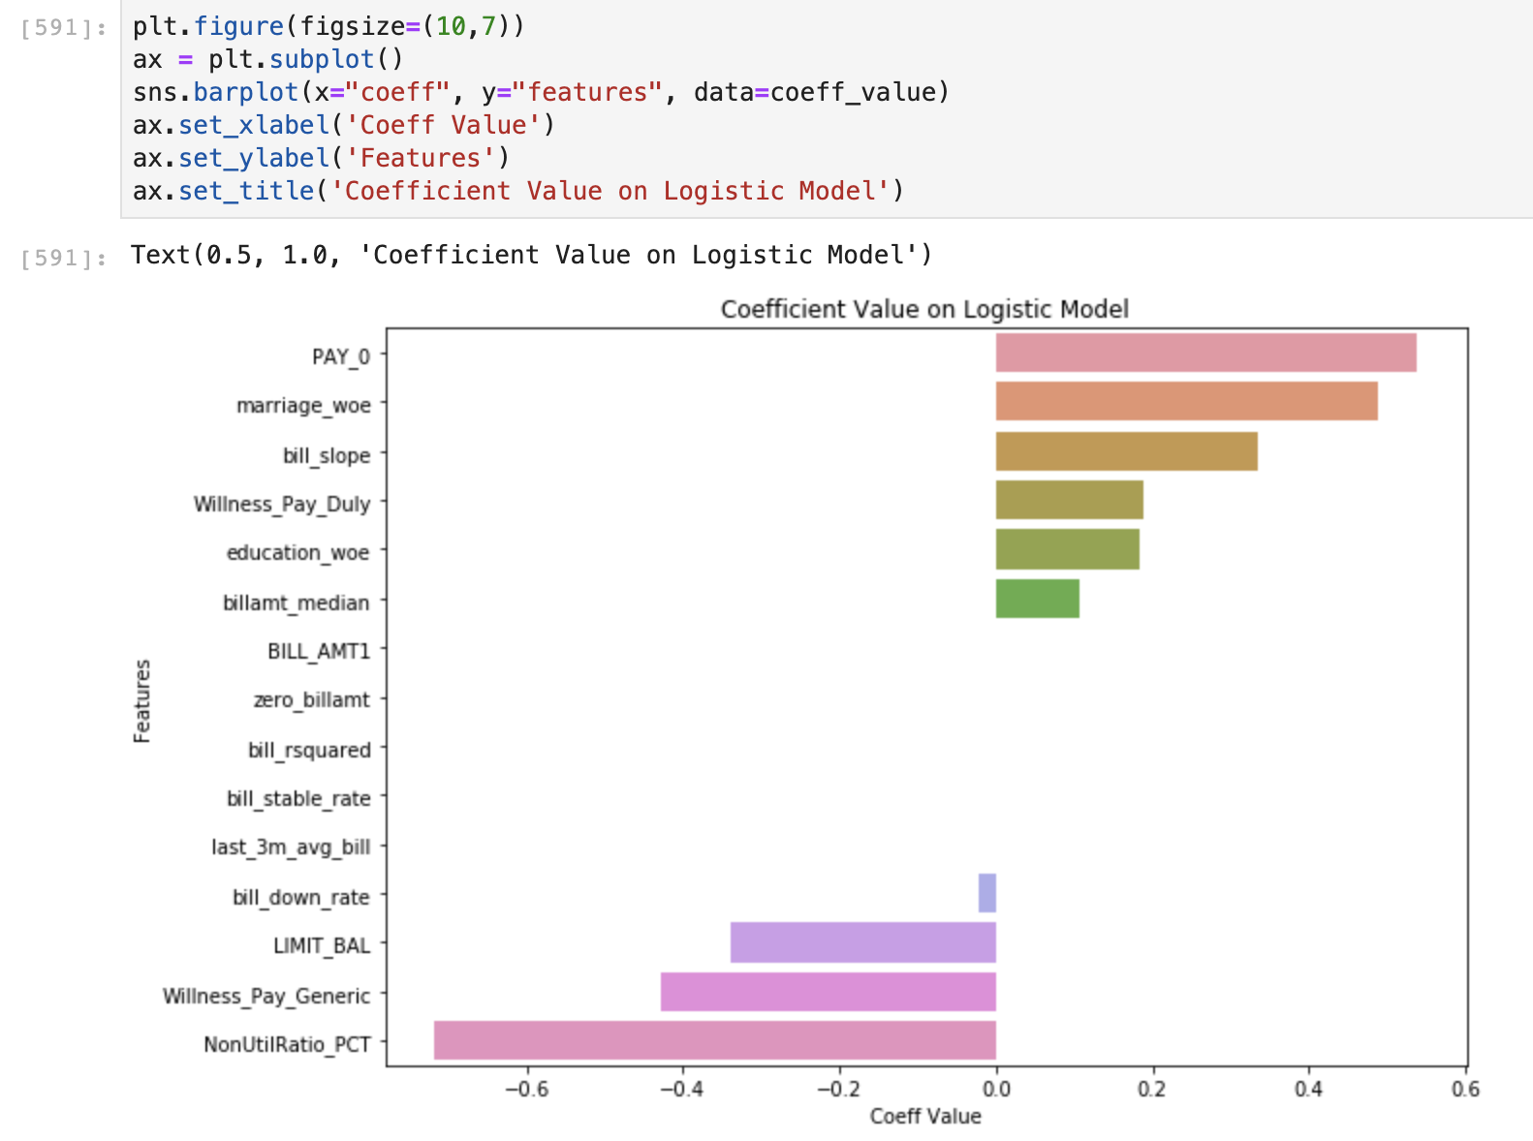
Feature Significant Power
Positive Direction toward Default
The more late ( >=1 ) current repayment status (PAY_0), it indicates borrower will more likely to unable to pay their next repayment cycle.
Marriage_WoE & education_WoE adjusting as our hypothesis by applying Weight of Evidence for Marriage Categorical (see slide 19)
Bill slope indicates the higher our amount grow over 6M (slope of the amount line), have quite significant power toward default label.
Negative Direction toward Default
The more frequent borrower using credit card lending, indicating less likelihood toward default the strongest, and also with the Willingness to Pay Feature
Here, Limit Balance is already showing a negative power because of it is likely already being derivatives from Application Scores or previous Behavior Scoring (see CLIP slide 7)
Notes:
Very explainable features because we clean the bad data and using the feature engineered adjusting the Lending and Consumer Lending domain.

Slide 33
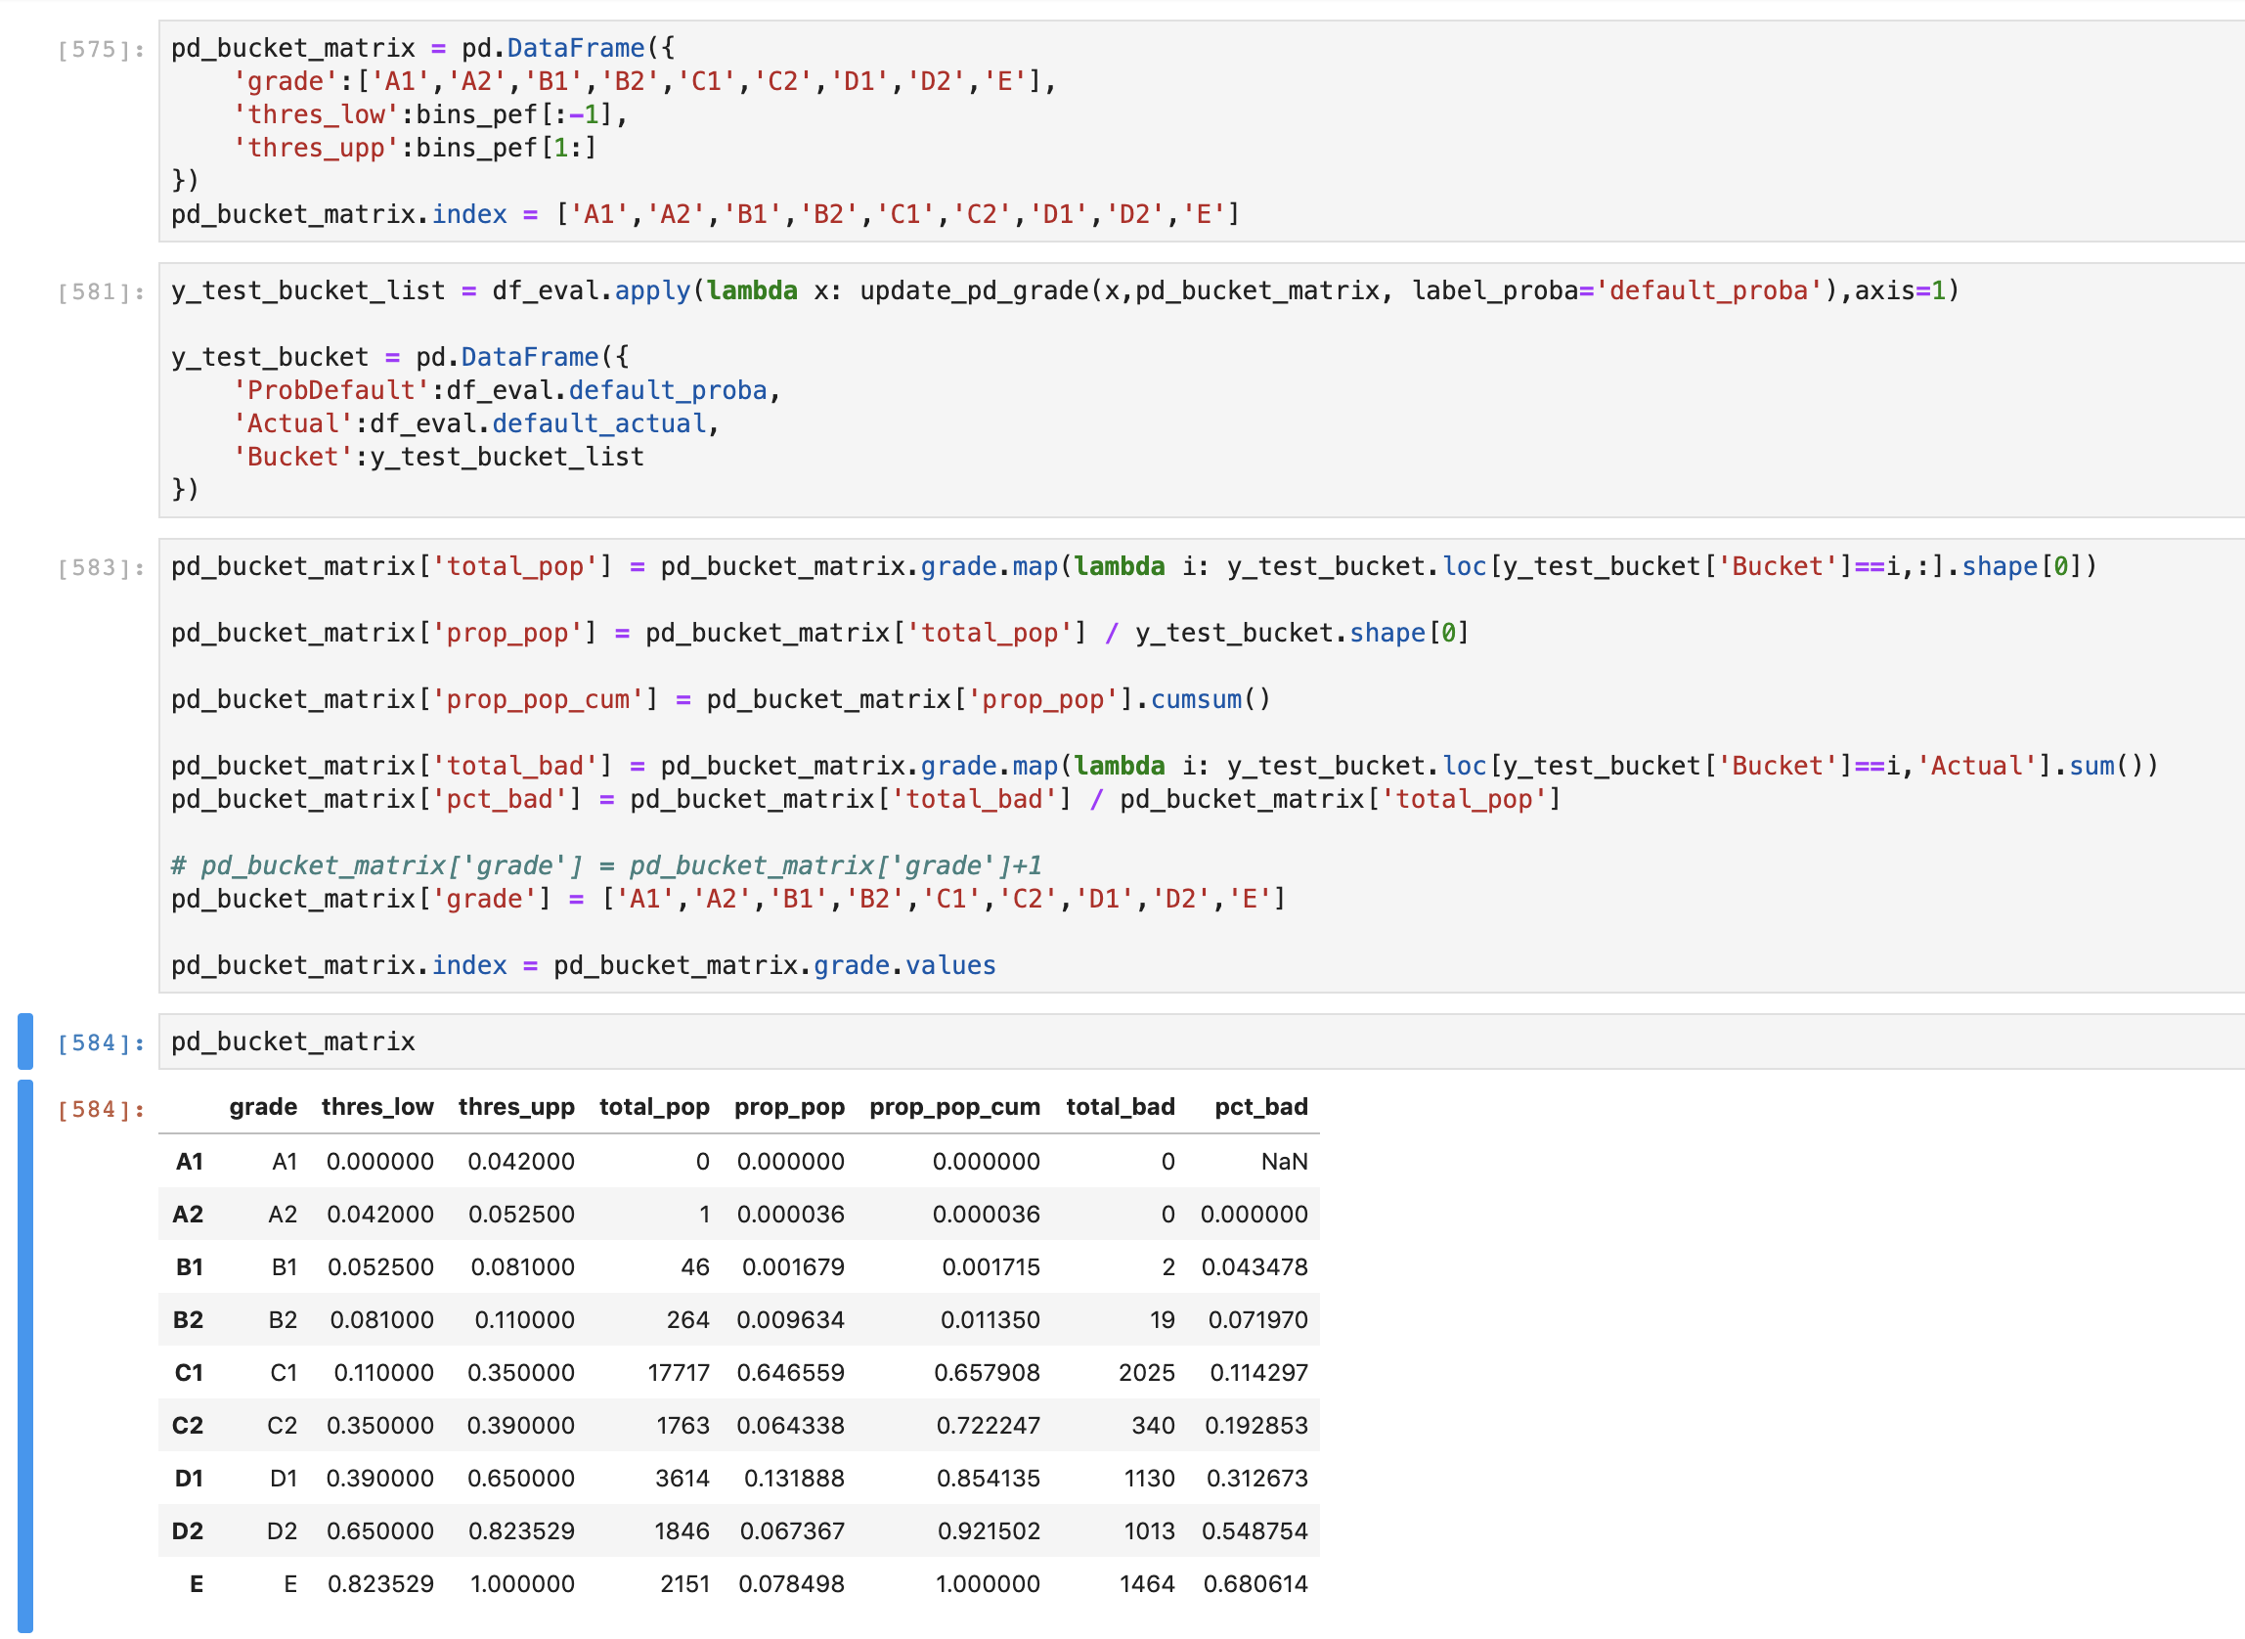
Risk Rank Bucketing based on PD Predict
Risk Rank Bucketing
We designed Risk Rank bucket with grade [ A1, A2, B1, B2, C1, C2, D1, D2, E] following Basel Format. The purpose of having few separate bucket so we can have exact cut off adjusting several metrics.
It shown that at C1, the percentage of Bad Rate is on the rise to 11% of whole population. Usually one of our metrics that we take a look is bad rate pop approx. 10%, hence I recommend to cut off our approval for CLIP or EWS (Early Warning System) from C1
Notes:
Very explainable features because we clean the bad data and using the feature engineered adjusting the Lending and Consumer Lending domain.

Slide 34
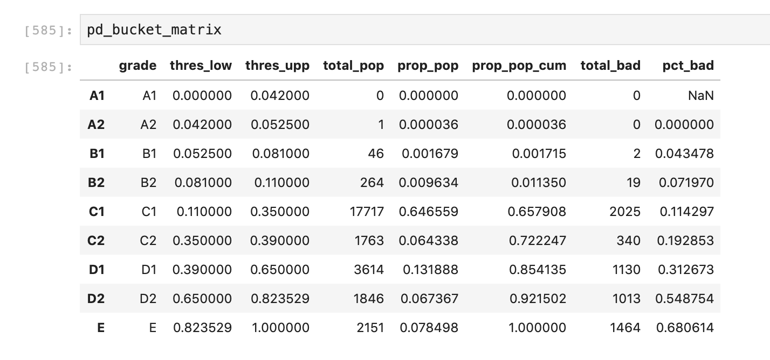
Risk Rank Bucketing based on PD Predict
Risk Rank Bucketing
We designed Risk Rank bucket with grade [ A1, A2, B1, B2, C1, C2, D1, D2, E] following Basel Format. The purpose of having few separate bucket so we can have exact cut off adjusting several metrics.
It shown that at C1, the percentage of Bad Rate is on the rise to 11% of whole population. Usually one of our metrics that we take a look is bad rate pop approx. 10%, hence I recommend to cut off our approval for CLIP or EWS (Early Warning System) from C1
Notes:
Very explainable features because we clean the bad data and using the feature engineered adjusting the Lending and Consumer Lending domain.

Slide 35
Caveat
Macro Economy is stable over the time this Risk Rank Bucket designed, otherwise we should see significant behavior among those similar population.
We need more of personalised purchase of products, external scoring like Credit Bureau (Pefindo in Indonesia case), or related marketplace data in order to have enrich more data to have multiple perspective of repayment behavior.

Slide 36

Final point
Lending domain and statistically proven features are more meaningful plus bring more predictive power to the model.
So explainability does not always negative correlation with predictive power.

Slide 37
We could apply linear optimisation to automate risk rank bucketing process, to maintain acceptance population while gaining optimum outstanding amount and badrate.

Slide 38
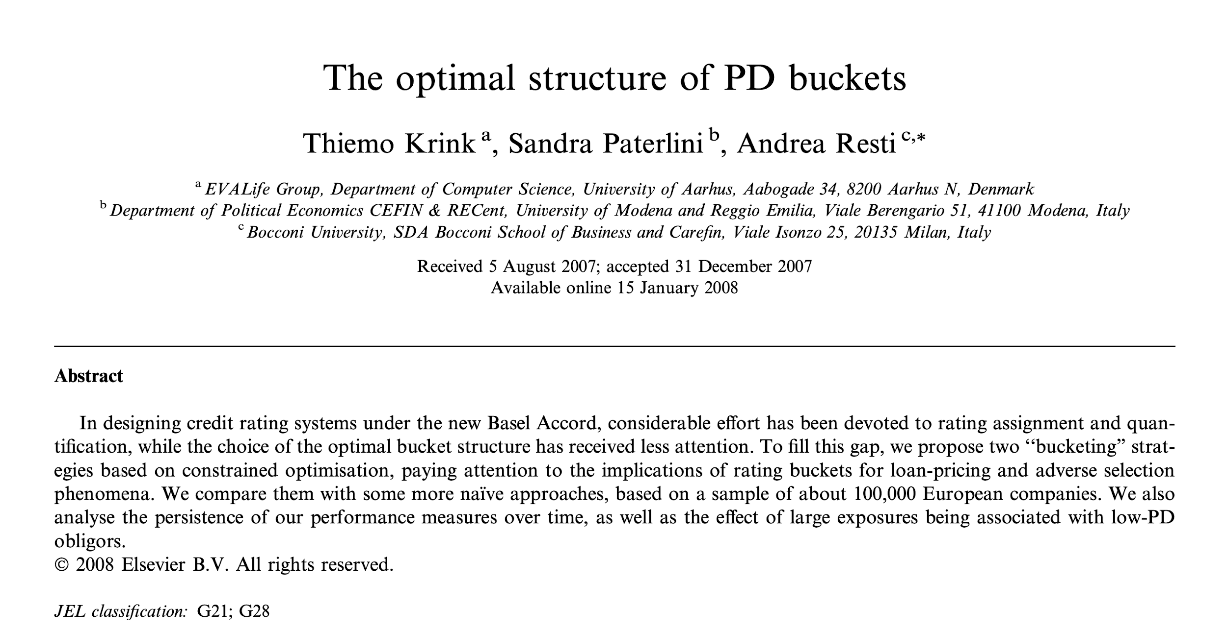

Slide 39
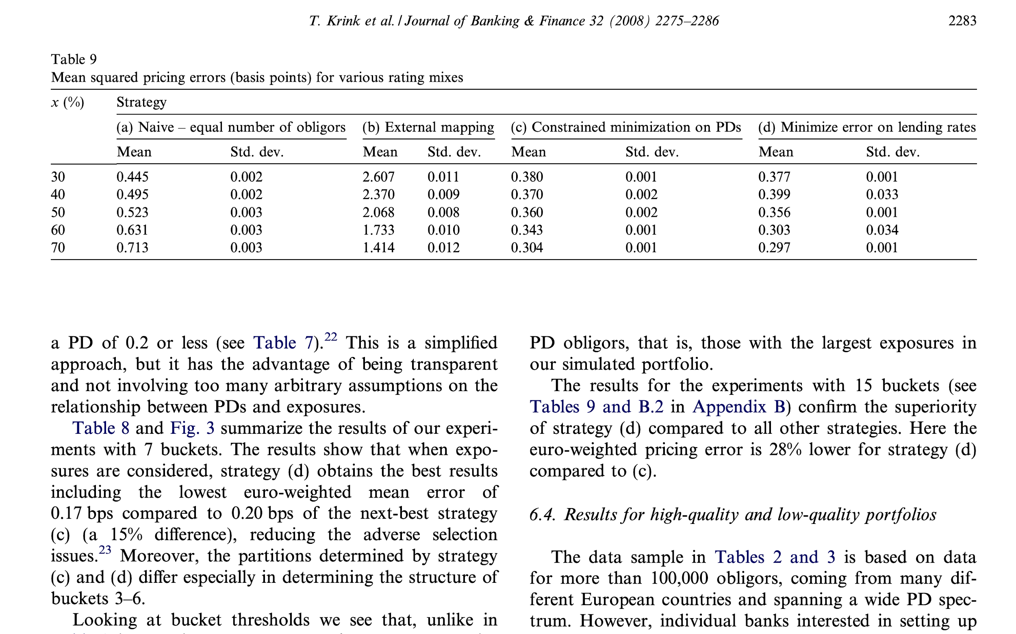

Slide 40

END OF PROGRESS
ARIS FERNANDO
arisffernando@gmail.com
https://id.linkedin.com/in/arisfernando

